Slide 1
Text Mining (Part II: Embedding, Information Extraction & Text Cube)
Jiawei Han
Computer Science
University of Illinois at Urbana-Champaign
March 30, 2017

Slide 2
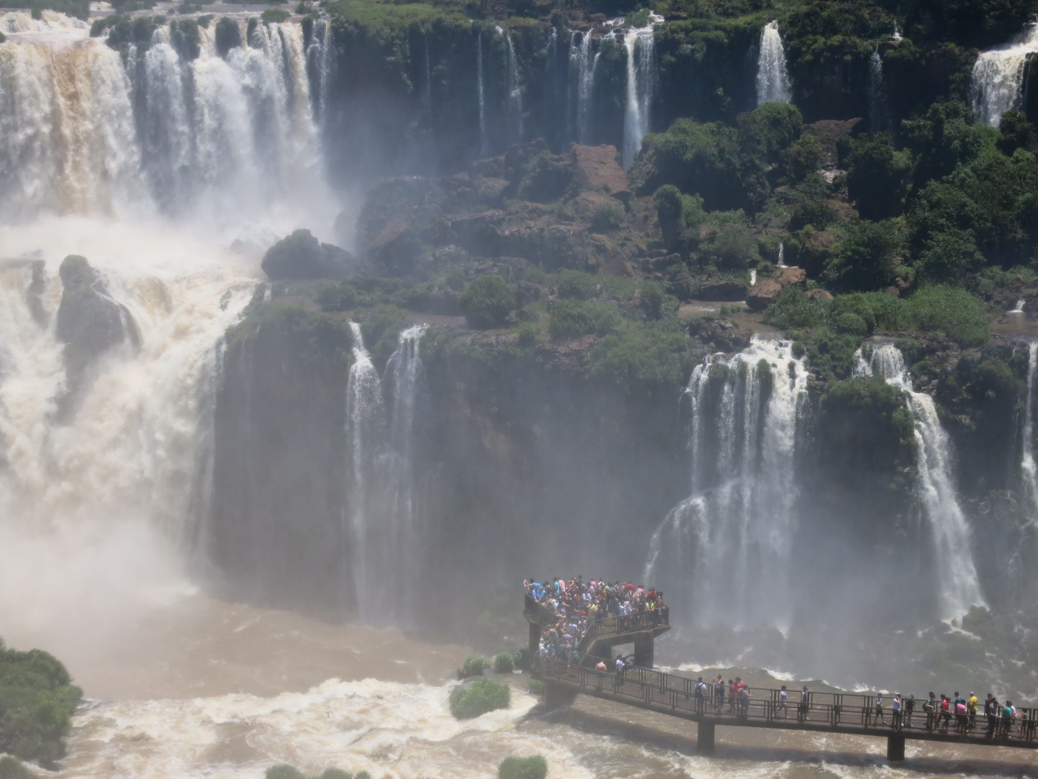

Slide 3
Outline
Learning Embeddings in Networks and Text
LINE: Large-scale Information Network Embedding
Biological Relationship Discovery with Network Embedding
LAKI: Representing Documents via Latent Keyphrase Inference
MetaPAD: Meta Pattern Discovery from Massive Text Corpora
TextCube, EventCube and CaseOLAP
Summary

Slide 4
Information Network Analysis
A lot of interesting problems
Node classification
Link prediction
Visualization
Input of most algorithms
Low-dimensional feature vector of every vertex
How to get the feature vectors?
From the context information of vertices
From the network structure
How?

Slide 5
LINE and Its Hypothesis
LINE paper: J. Tang, M. Qu, M. Wang, M. Zhang, J. Yan, and Q. Mei, “LINE: Large-scale information network embedding”, WWW'15
Nodes with strong ties turn to be similar
1st order similarity
Nodes share many neighbors turn to be similar
2nd order similarity
Well-learnt embedding should preserve both 1st order and 2nd order similarity
Nodes 6 & 7: high 1st order similarity
Nodes 5 & 6: high 2nd order similarity

Slide 6
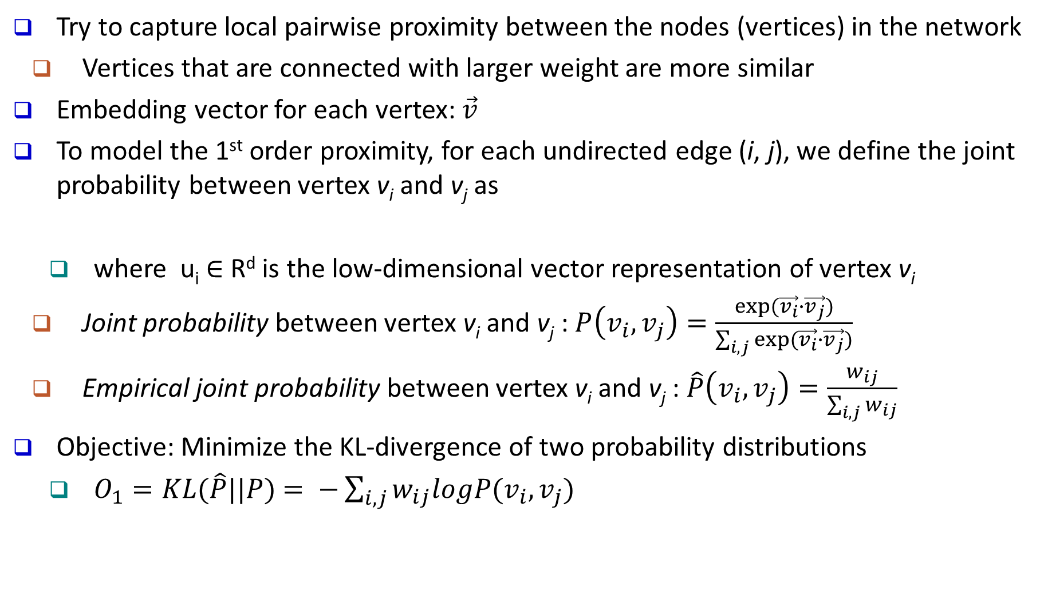
LINE: 1st Order Similarity
Try to capture local pairwise proximity between the nodes (vertices) in the network
Vertices that are connected with larger weight are more similar
Embedding vector for each vertex: $\vec{v}$
To model the 1st order proximity, for each undirected edge (i, j), we define the joint probability between vertex v_{i} and v_{j} as
where u_{i} ∈ R^{d} is the low-dimensional vector representation of vertex v_{i}
Joint probability between vertex v_{i} and v_{j} : $P\left(v_{i},v_{j}\right)=\frac{exp⁡(\vec{v_{i}}∙\vec{v_{j}})}{\sum_{i,j}{exp⁡(\vec{v_{i}}∙\vec{v_{j}})}}$
Empirical joint probability between vertex v_{i} and v_{j} : $\hat{P}\left(v_{i},v_{j}\right)=\frac{w_{ij}}{\sum_{i,j}{w_{ij}}}$
Objective: Minimize the KL-divergence of two probability distributions
$O_{1}=KL(\hat{P}||P)$ $= −\sum_{i,j}{w_{ij}logP(v_{i},v_{j})}$

Slide 7
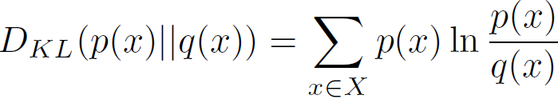
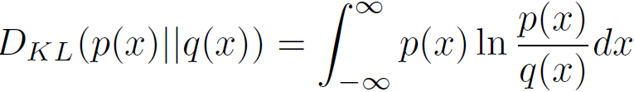
KL Divergence: Comparing Two Probability Distributions
The Kullback-Leibler (KL) divergence: Measure the difference between two probability distributions over the same variable x
From information theory, closely related to relative entropy, information divergence, and information for discrimination
D_{KL}(p(x) || q(x)): divergence of q(x) from p(x), measuring the information lost when q(x) is used to approximate p(x)
Discrete form:
The KL divergence measures the expected number of extra bits required to code samples from p(x) (“true” distribution) when using a code based on q(x), which represents a theory, model, description, or approximation of p(x)
Its continuous form:
Not a distance measure, not a metric: asymmetric, not satisfy triangular inequality

Slide 8
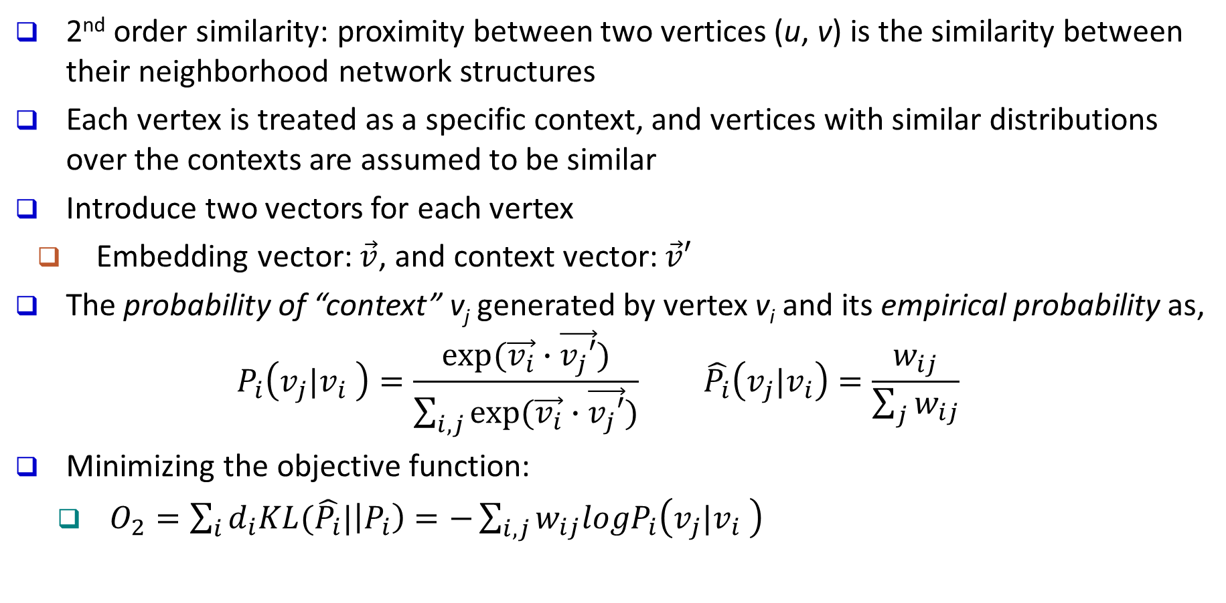
LINE: 2nd Order Similarity
2nd order similarity: proximity between two vertices (u, v) is the similarity between their neighborhood network structures
Each vertex is treated as a specific context, and vertices with similar distributions over the contexts are assumed to be similar
Introduce two vectors for each vertex
Embedding vector: $\vec{v}$, and context vector: $\vec{v}′$
The probability of “context” v_{j} generated by vertex v_{i} and its empirical probability as,
$$P_{i}\left(v_{j}|v_{i} \right)=\frac{exp⁡(\vec{v_{i}}∙\vec{v_{j}′})}{\sum_{i,j}{exp⁡(\vec{v_{i}}∙\vec{v_{j}′})}} \hat{P_{i}}\left(v_{j}|v_{i}\right)=\frac{w_{ij}}{\sum_{j}{w_{ij}}}$$
Minimizing the objective function:
$O_{2}=\sum_{i}{d_{i}KL(\hat{P_{i}}|\left|P_{i}\right)=−\sum_{i,j}{w_{ij}logP_{i}\left(v_{j}|v_{i} \right)}}$

Slide 9
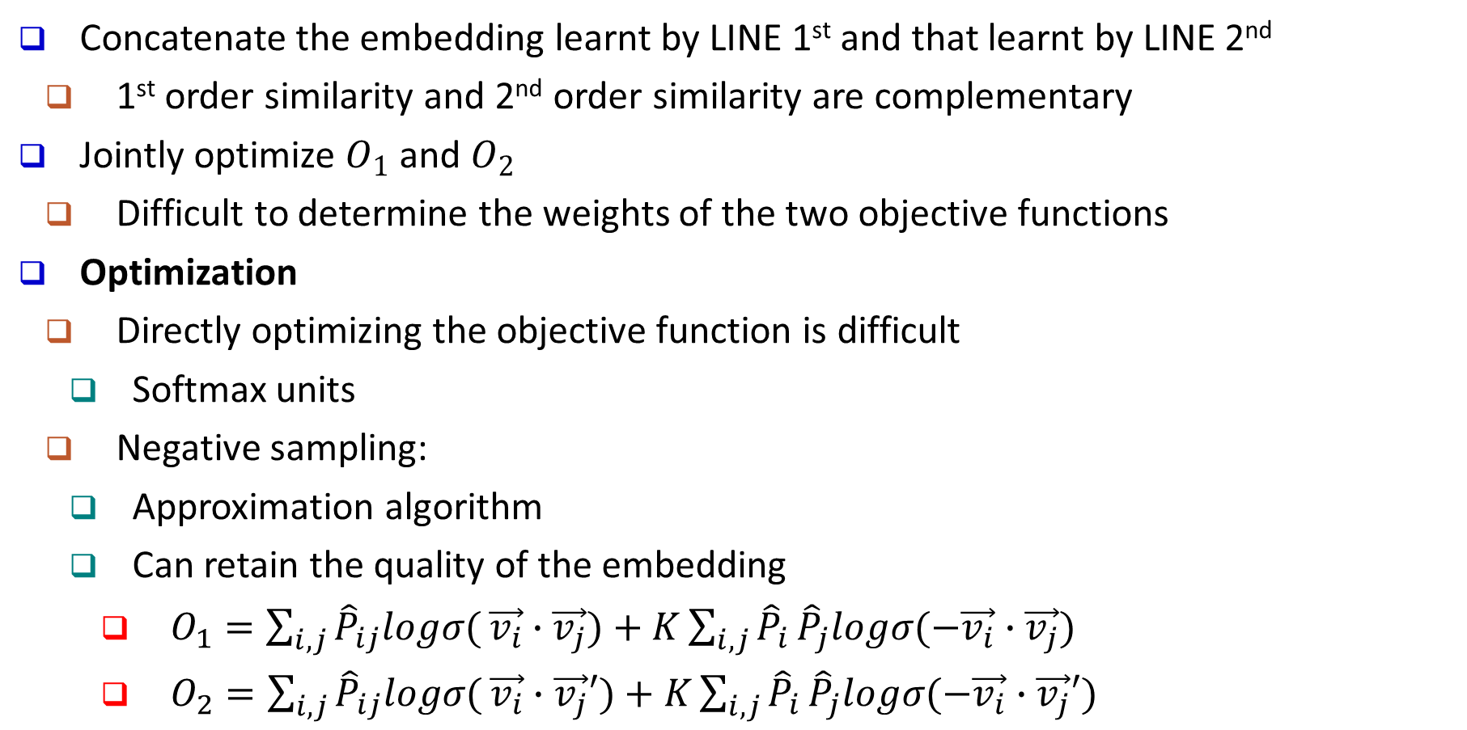
Combining LINE 1st and LINE 2nd Order Similarity
Concatenate the embedding learnt by LINE 1st and that learnt by LINE 2nd
1st order similarity and 2nd order similarity are complementary
Jointly optimize $O_{1}$ and $O_{2}$
Difficult to determine the weights of the two objective functions
Optimization
Directly optimizing the objective function is difficult
Softmax units
Negative sampling:
Approximation algorithm
Can retain the quality of the embedding
$O_{1}=\sum_{i,j}{{\hat{P}}_{ij}logσ(}\vec{v_{i}}∙\vec{v_{j}})+K\sum_{i,j}{{\hat{P}}_{i}}{\hat{P}}_{j}logσ(−\vec{v_{i}}∙\vec{v_{j}})$
$O_{2}=\sum_{i,j}{{\hat{P}}_{ij}logσ(}\vec{v_{i}}∙\vec{v_{j}}′)+K\sum_{i,j}{{\hat{P}}_{i}}{\hat{P}}_{j}logσ(−\vec{v_{i}}∙\vec{v_{j}}′)$

Slide 10
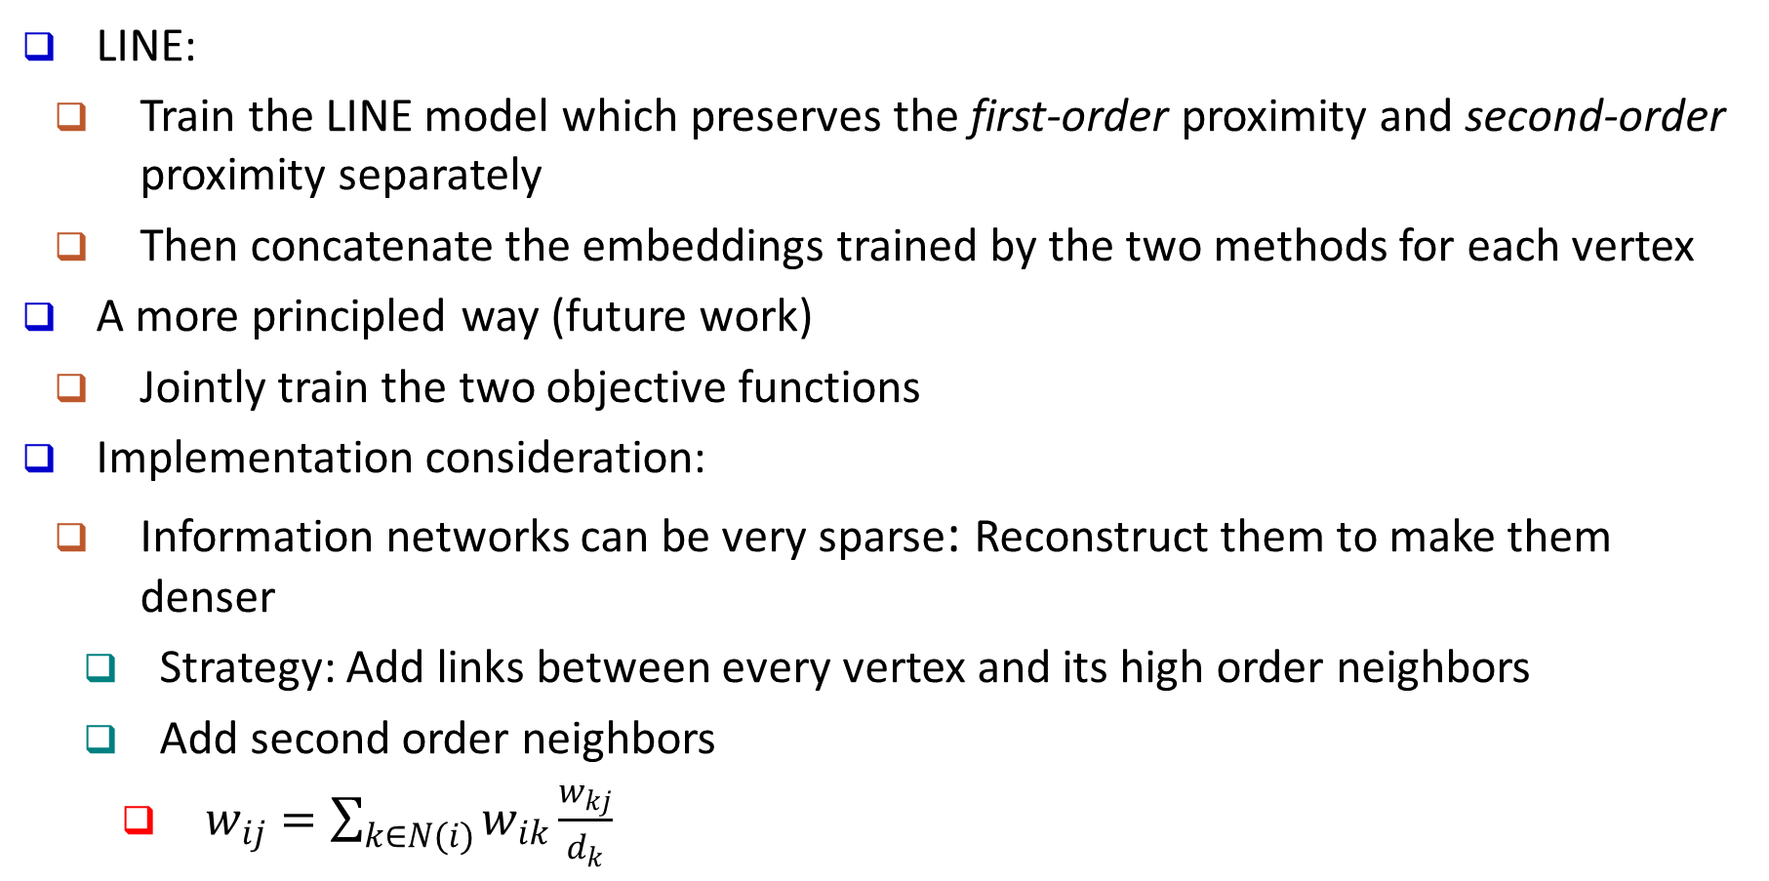
Algorithm LINE and Some Practical Issues
LINE:
Train the LINE model which preserves the first-order proximity and second-order proximity separately
Then concatenate the embeddings trained by the two methods for each vertex
A more principled way (future work)
Jointly train the two objective functions
Implementation consideration:
Information networks can be very sparse: Reconstruct them to make them denser
Strategy: Add links between every vertex and its high order neighbors
Add second order neighbors
$w_{ij}=\sum_{k∈N(i)}{w_{ik}\frac{w_{kj}}{d_{k}}}$

Slide 11
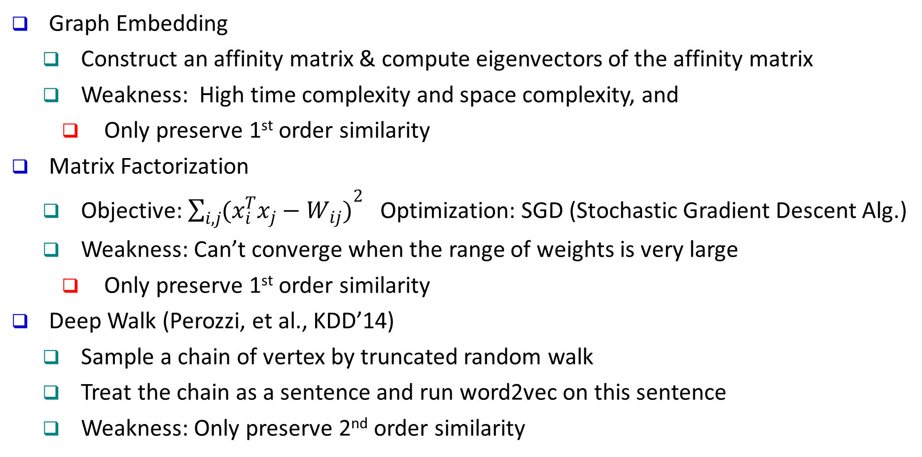
Previous Work
Graph Embedding
Construct an affinity matrix & compute eigenvectors of the affinity matrix
Weakness: High time complexity and space complexity, and
Only preserve 1st order similarity
Matrix Factorization
Objective: $\sum_{i,j}{{(x_{i}^{T}x_{j}−W_{ij})}^{2}}$Optimization: SGD (Stochastic Gradient Descent Alg.)
Weakness: Can’t converge when the range of weights is very large
Only preserve 1st order similarity
Deep Walk (Perozzi, et al., KDD’14)
Sample a chain of vertex by truncated random walk
Treat the chain as a sentence and run word2vec on this sentence
Weakness: Only preserve 2nd order similarity

Slide 12
Experiment Setup
Dataset
Task
Word analogy: Evaluated on Accuracy
Document classification: Evaluated on Macro-F1 Micro-F1
Vertex classification: Evaluated on Macro-F1 Micro-F1
Result visualization

Slide 13
Results: Language Networks
Word Analogy
GF (Graph Factorization) Ahmed et al., WWW2013)
Document Classification

Slide 14
Results: Social Networks
Flickr dataset
Youtube dataset

Slide 15
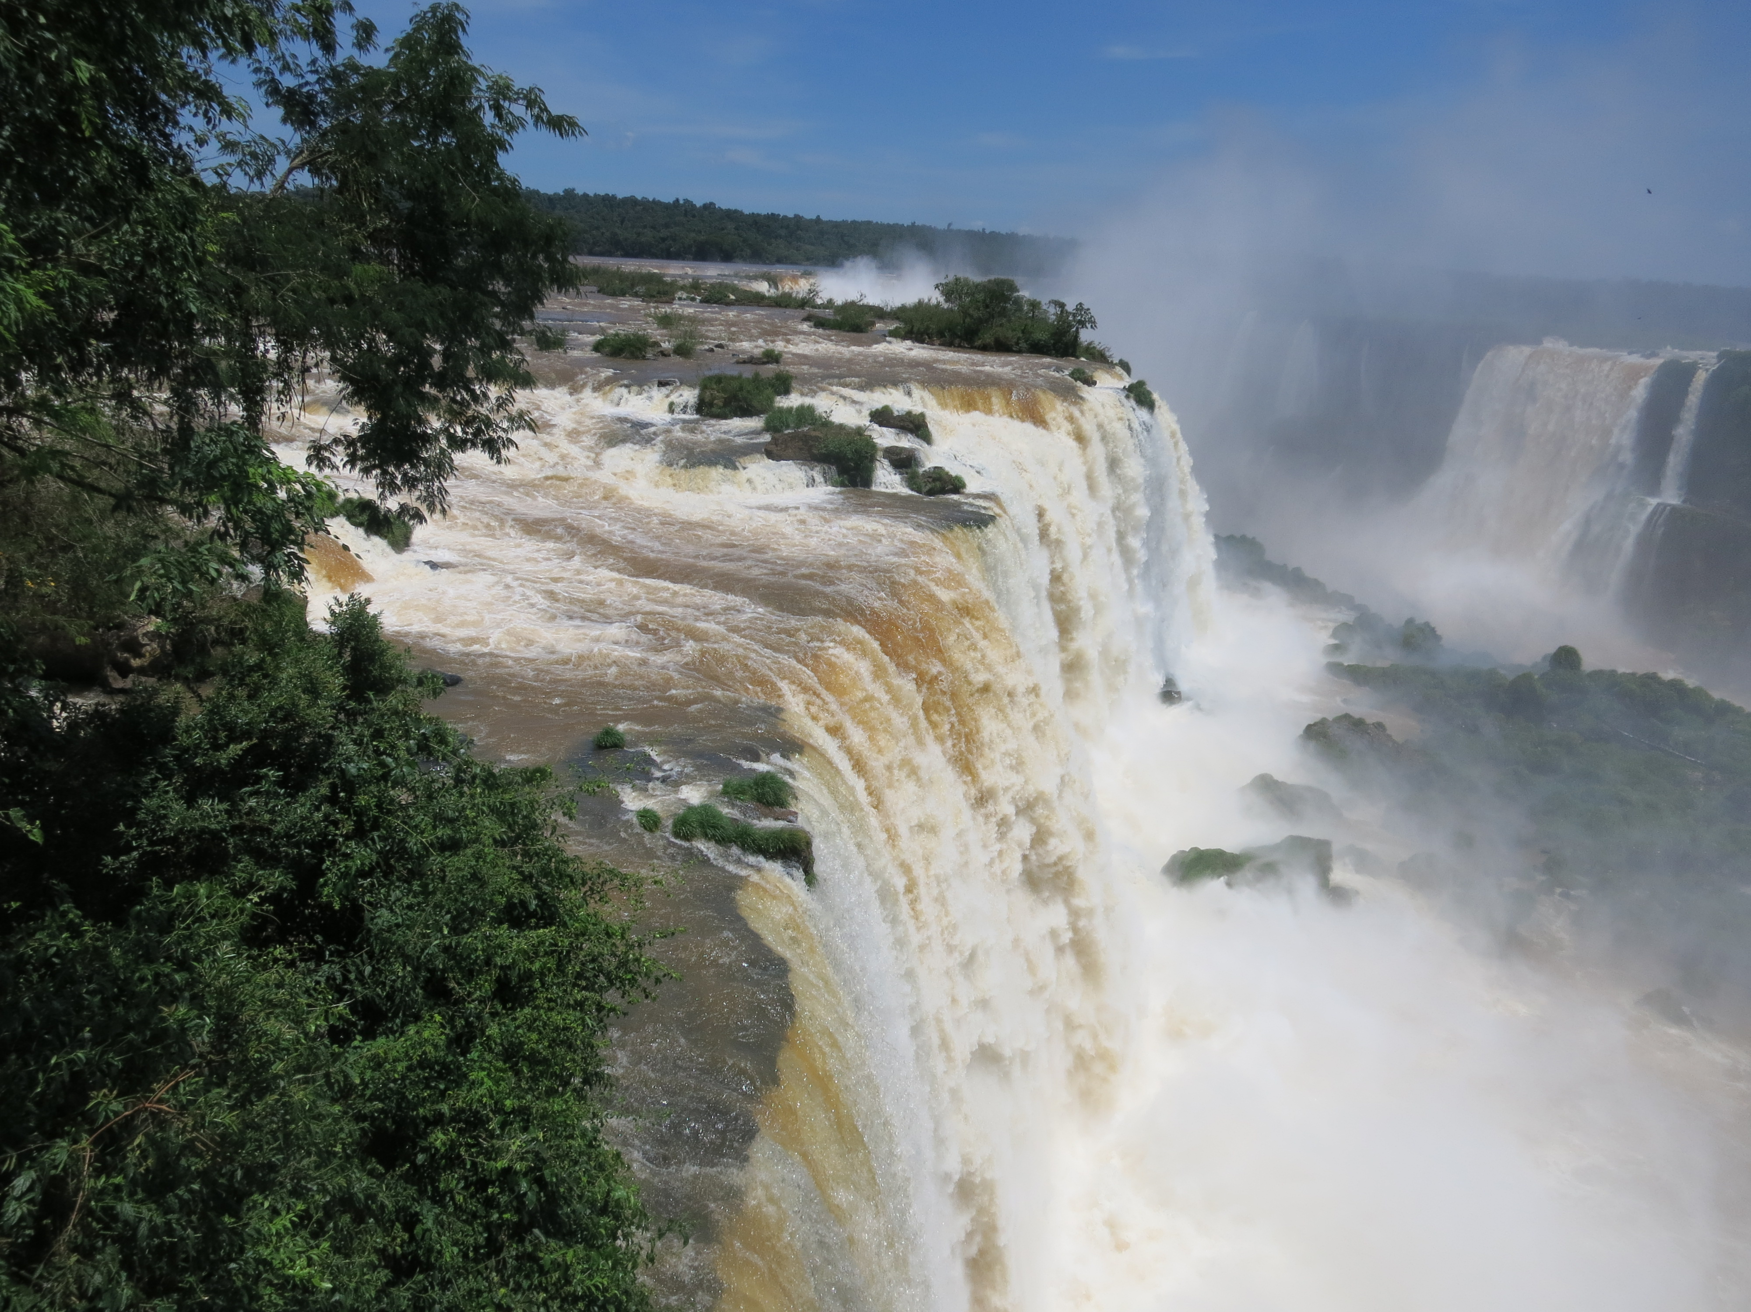

Slide 16
Outline
Learning Embeddings in Networks and Text
LINE: Large-scale Information Network Embedding
Biological Relationship Discovery with Network Embedding
LAKI: Representing Documents via Latent Keyphrase Inference
MetaPAD: Meta Pattern Discovery from Massive Text Corpora
TextCube, EventCube and CaseOLAP
Summary

Slide 17
Biological Relationship Extraction
Problem description: Automatic extraction of relationships between different biological entities from biological research papers
Examples
Gene – Disease; Drug - Disease; Drug - Pathway; Drug - Target gene
Challenges
Entity detection
Most biological entities consist of several words
E.g., Non-small Cell Lung Cancer, Acute Myeloid Leukemia
Sparsity
Most biological entities co-occur only a few times in research papers
Most relationships are not explicitly described in papers
Few Labeled data

Slide 18
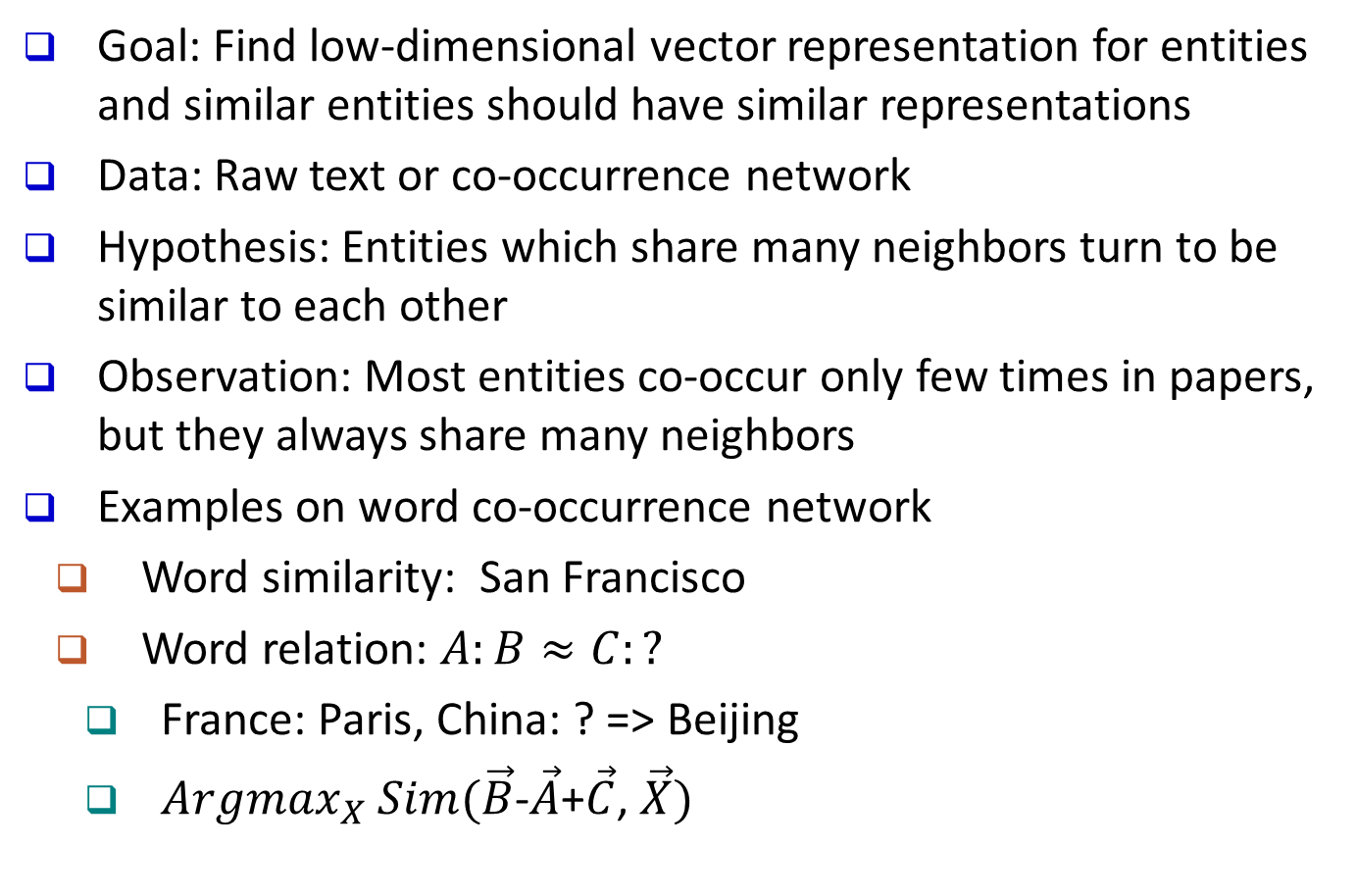
Overview of Embedding-Based Methods
Goal: Find low-dimensional vector representation for entities and similar entities should have similar representations
Data: Raw text or co-occurrence network
Hypothesis: Entities which share many neighbors turn to be similar to each other
Observation: Most entities co-occur only few times in papers, but they always share many neighbors
Examples on word co-occurrence network
Word similarity: San Francisco
Word relation: $A:B≈C:?$
France: Paris, China: ? => Beijing
${Argmax}_{X} Sim(\vec{B}$-$\vec{A}$+$\vec{C}$, $\vec{X})$

Slide 19
Framework
Construct a biological entity list
SegPhrase
Biological vocabulary
Detect and extract biological entities from biological text (research papers), using
SegPhrase
Maximum Matching
Construct a co-occurrence network between words and biological entities
Learn embedding vector for each entity by using a network embedding technique LINE (i.e., Run LINE-2nd to learn entity embeddings)
Entities share many neighbors in the co‐occurrence network tend to be similar
Given seed entity pair (a, b) and a query entity x, return an entity y according to their embedding vectors, so that the relation between x and y is similar to the relation between a and b.

Slide 20
Key Property to Learn Embedding & Experiments
Key Property to Learn Embedding
The lines between genes and diseases are parallel
Given a seed pair (𝐴,𝐵) and a query 𝑋, we can find an entity 𝑌 which satisfies
(𝐴,𝐵) ≈ (𝑋, 𝑌)
𝑌 = 𝐴𝑟𝑔𝑚𝑎𝑥/𝑠𝑖𝑚(𝐵 − 𝐴⃗ + 𝑋, 𝑌)
Experimental Settings
Sample 10% Pubmed abstracts
Detect phrases by using a 200K phrase list
Build a co-occurrence network for all words and phrases
Learn entity embedding from the co-occurrence network

Slide 21
Experimental Results: Find Related Entities
t-cell
Leukemia
Doxorubicin
Tumor Suppressor Gene

Slide 22
Extracted Relations (from 10% PubMed Abstracts)

Slide 23
Relation: Drug-Target Gene
Very difficult as there are too many genes
Use (Camptothecin: top1) as seed pair
Metric: rank of the first-hit target gene
Compare with a paper published on CELL
Drug | Embedding | CELL Paper
cycloheximide | 10 | 1
doxorubicin hydrochloride | 1998 | 1000
etoposide | 9 | 13
geldanamycin | 426 | 5
methotrexate | 3 | 6
monastrol | 1116 | 1000
rapamycin | 5 | 11
trichostatin | 7 | 100

Slide 24
Future Work
Use more context information
By using topic assignment of words as extra features, the performance on word analogy task is improved
Use biological networks
Well constructed with little noise
Exploring multi-typed information networks
Integration of expert-provided type information and automated type extraction (e.g., ClusType)
Exploring meta-path
Add a regularization term to the model

Slide 25
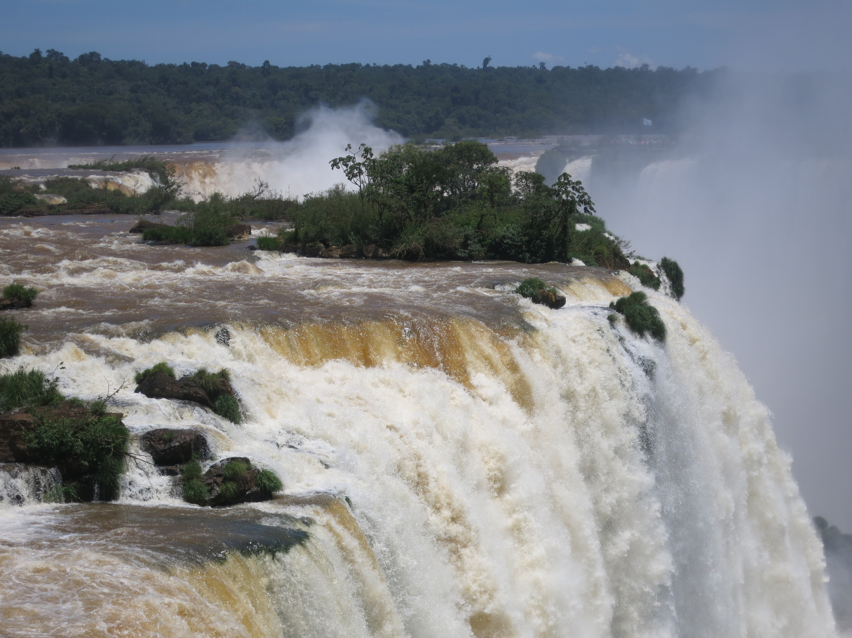

Slide 26
Outline
Learning Embeddings in Networks and Text
LINE: Large-scale Information Network Embedding
Biological Relationship Discovery with Network Embedding
LAKI: Representing Documents via Latent Keyphrase Inference
MetaPAD: Meta Pattern Discovery from Massive Text Corpora
TextCube, EventCube and CaseOLAP
Summary

Slide 27
LAKI: Representing Documents via Latent Keyphrase Inference
Jialu Liu, Xiang Ren, Jingbo Shang, Taylor Cassidy, Clare Voss and Jiawei Han, "Representing Documents via Latent Keyphrase Inference", WWW'16
Document Representation
A document can be represented by
A set of works, topics, KB concepts,
Keyphrases, …
Words:
dbscan, methods, clustering, process, …
Document
Representation
Topics:
[k-means, clustering, clusters, dbscan, …]
[clusters, density, dbscan, clustering, …]
[machine, learning, knowledge, mining, …]
documents
Knowledge base concepts:
data mining: /m/0blvg
clustering analysis: /m/031f5p
dbscan: /m/03cg_k1
Document keyphrase:
dbscan: [dbscan, density, clustering, ...]
clustering: [clustering, clusters, partition, ...]
data mining: [data mining, knowledge, ...]

Slide 28
Document Representation: Traditional Methods
Bag-of-Words or Bag-of-Phrases
Cons: Sparse on short texts
Topic models [LDA]
Each topic is a distribution over words; each document is a mixture of corpus-wide topics
Cons: Difficult for human to infer topic semantics

Slide 29

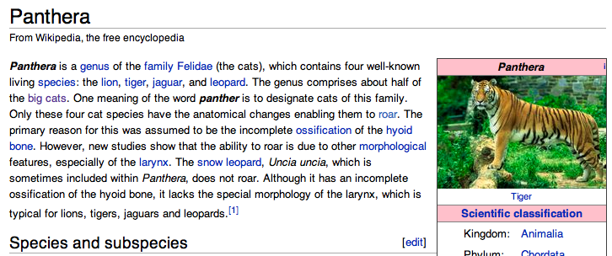
Document Representation: Concept-based models [ESA]
Concept-based models [ESA]
Cons: Low coverage of concepts in human-curated knowledge base
Every Wikipedia article represents a concept
Concept:Panthera
Cat [0.92]
Leopard [0.84]
Roar [0.77]
Article words are associated with the concept (TF.IDF), which help infer concepts from document

Slide 30
Document Representation: Word2Vect
Word/document embedding models [word2vec]
Cons: Difficult to explain what each dimension means

Slide 31
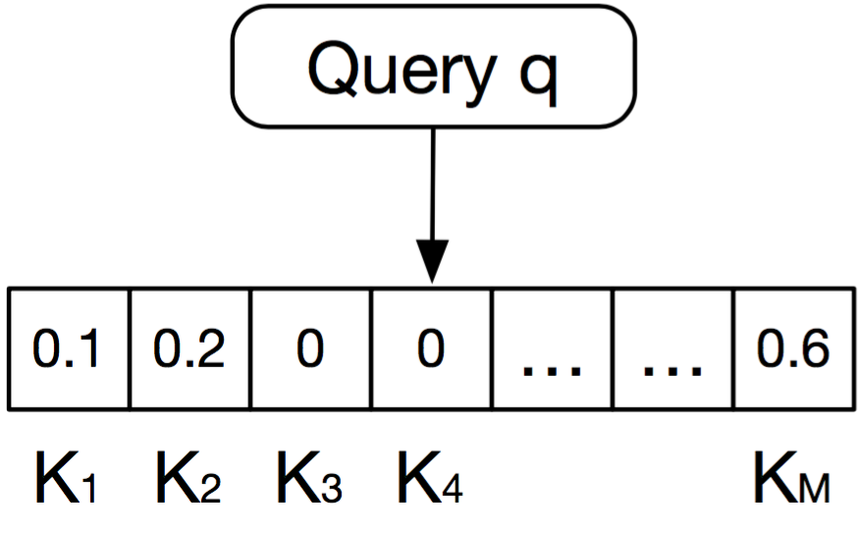
Document Representation Using Keyphrases
Use quality phrases as the entries in the vector and identify document keyphrases (subset of quality phrases) by evaluating relatedness between (doc, quality phrase)
Unsupervised model
Challenges
Where to get quality phrases from a given corpus?
Mining Quality Phrases from Massive Text Corpora [SIGMOD15]
How to identify document keyphrases?
Can be latent mentions
Relatedness scores
How to deal with relationship between quality phrases?
Corpus
Quality Keyphrases <K₁, K₂, …, K_{M}>

Slide 32
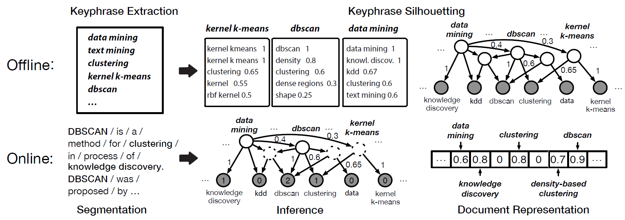
Document Representation Using Keyphrases: General Ideas
How to identify document keyphrases?
Powered by Bayesian Inference on “Quality Phrase Silhouette”
Quality Phrase Silhouette: Topic centered on quality phrase
“Reverse” topic models
“Pseudo content” for quality phrase
How to deal with relationship between quality phrases?
Phrases are interconnected as a Directed Acyclic Graph
Networking
Text Mining
Data Mining

Slide 33
Framework for Latent Keyphrase Inference (LAKI)

Slide 34
LAKI: Deriving Quality Phrase Silhouette
Learning Hierarchical Bayesian Network (DAG)
Binary Variables
Task 1: Model Learning: Learning link weights
Task 2: Structure Learning: Learning network structure

Slide 35
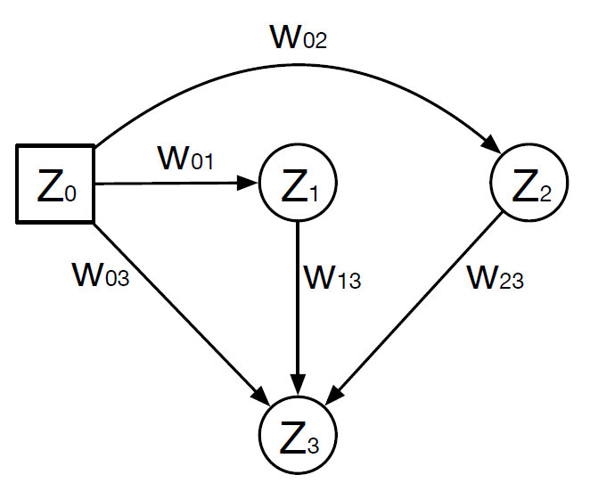
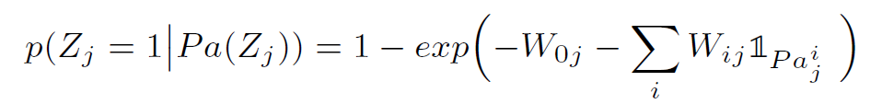
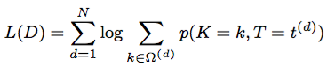
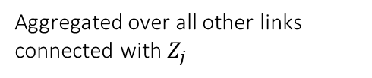
Deriving Quality Phrase Silhouette Task 1: Model Learning Given Structure
Use Z to represent K (quality phrases) and T (content units)
Noisy-OR
A parent node is easier to activate its children when the link weight is larger
A child node is influenced by all its parents
Noise / Prior
Aggregated over all other links connected with $Z_{j}$
Maximum Likelihood Estimation
Training data: Documents
Expectation-step: For each document, collect sufficient statistics
Link firing (Parent, child both being activated) probability
Node activation probability
Maximization-step: Update link weight
Toy example
Partially observed document keyphrases
Fully observed content units

Slide 36
Deriving Quality Phrase Silhouette Task 2: Structure Learning
Structure Learning
Quality phrases are connected to content units
Help infer document keyphrases from content units
Quality phrases are interconnected
Help infer document keyphrases from other keyphrases
A Heuristic Approach
Data-Driven, DAG, similar to ontology
Heuristic:
Two nodes are connected only
Closely Related: word2vec
Co-occur frequently
Links are always pointing to less frequent nodes
Works well in practice

Slide 37
LAKI: Inference
When do we need inference？
Expectation step in model learning
New documents
Why is it slow?
NP hard to compute posterior probability for Noisy-Or networks
Method: Approximate inference instead
Pruning irrelevant nodes using an efficient scoring function
Gibbs sampling

Slide 38
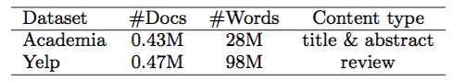
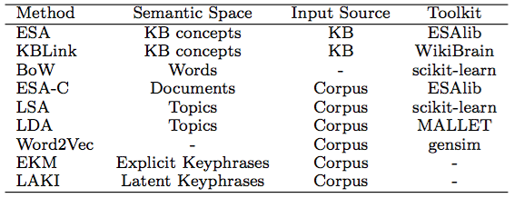
LAKI: Experiment Setting
Two text-related tasks to evaluate document representation quality
Phrase relatedness
Document classification
Two datasets:
Methods:
ESA (Explicit Semantic Analysis)
KBLink uses link structure in Wikipedia
BoW (bag-of-words)
ESA-C: extends ESA by replacing Wiki with domain corpus
LSA (Latent Semantic Analysis)
LDA (Latent Dirichlet Allocation)
Word2Vec is a neural network computing word embeddings
EKM uses explicit keyphrase detection

Slide 39
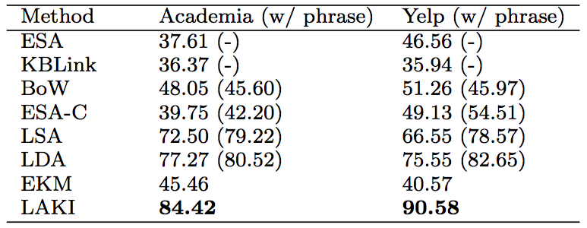
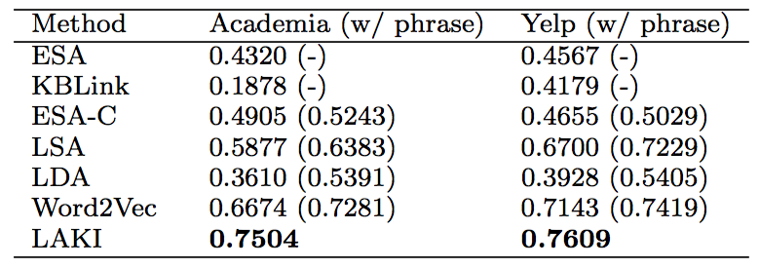
LAKI: Experimental Results
Phrase Relatedness Correlation
Document Classification
Time Complexity

Slide 40
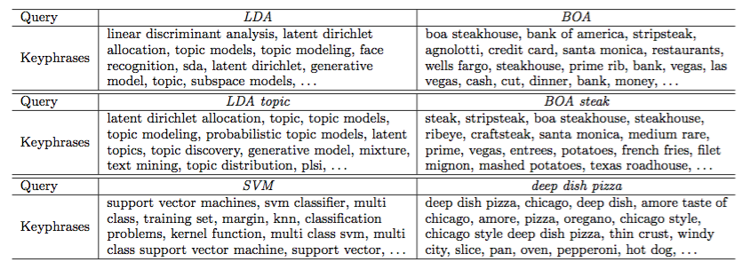
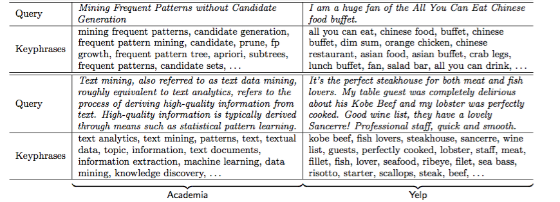
Case Study
Query on phrases
Academia
Yelp
Query on short documents (paper titles or sentences)
Academia
Yelp

Slide 41
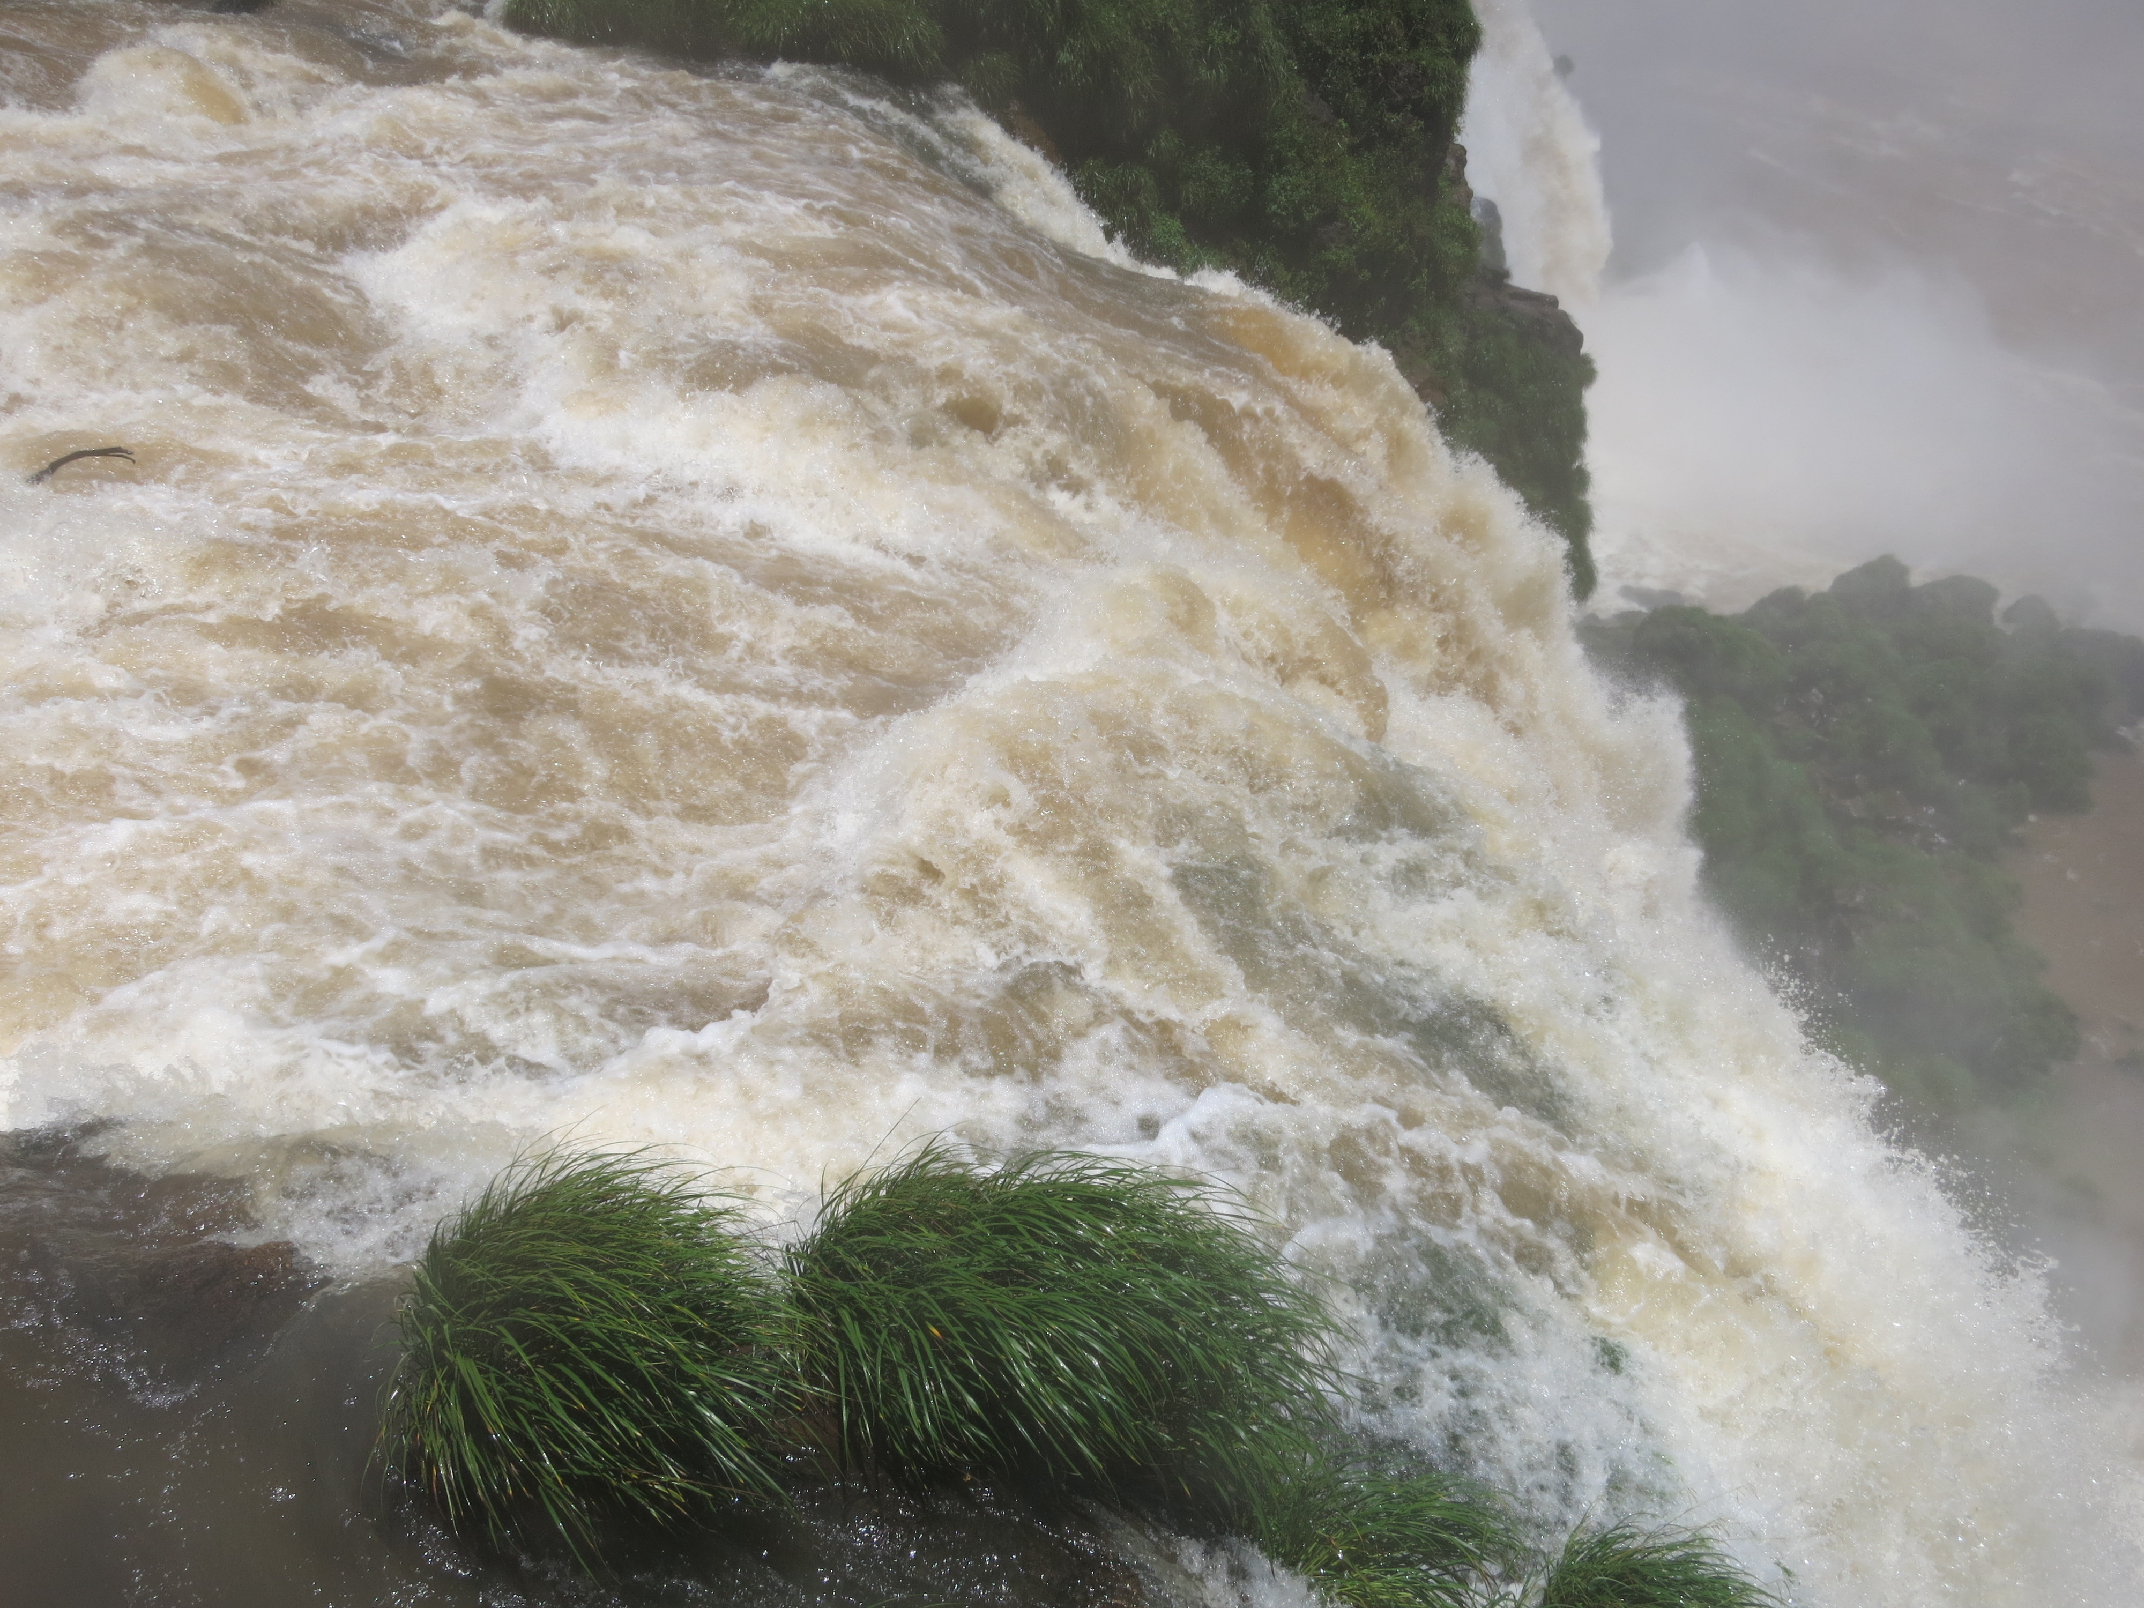

Slide 42
Outline
Learning Embeddings in Networks and Text
LINE: Large-scale Information Network Embedding
Biological Relationship Discovery with Network Embedding
LAKI: Representing Documents via Latent Keyphrase Inference
MetaPAD: Meta Pattern Discovery from Massive Text Corpora
TextCube, EventCube and CaseOLAP
Summary

Slide 43
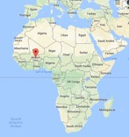
MetaPAD: Meta Pattern-driven Attribute Discovery from Massive Text Corpora
Meng Jiang, Jingbo Shang, Xiang Ren, Taylor Cassidy, Lance Kaplan, Timothy Hanratty, and Jiawei Han, “MetaPAD: Meta Pattern-driven Attribute Discovery from Massive Text Corpora”, submitted in 2017
Motivation:
Given a sentence in a large corpus, “President Blaise Compaoré’s government of Burkina Faso was founded…”, …
We may find:
age:65
Blaise Compaoré: $PERSON.POLITICIAN
Burkina Faso: $COUNTRY
president
population: 17 million
Attribute Discovery: Two tasks
Task 1: ⟨entity, attribute name, attribute value⟩
⟨Burkina Faso, president, Blaise Compaoré⟩
⟨Burkina Faso, population, 17 million⟩
⟨Blaise Compaoré, age, 65⟩
Task 2: ⟨entity type, attribute name⟩
⟨$COUNTRY, president⟩
⟨$COUNTRY, population⟩
⟨$PERSON, age⟩
Instance-level
Type-level

Slide 44
Previous Work on Finding E-A-V and Typed Patterns
Task 1: Finding E-A-V at the Instance Level
Stanford OpenIE [ACL’15], AI²’s Open IE-Ollie [EMNLP’12]
Learn syntactic and lexical patterns of expressing relations
Input: “President Blaise Compaoré’s government of Burkina Faso was founded…”
Output: ⟨President Blaise Compaoré, have, government of Burkina Faso⟩ ☹
Task 2: Finding Typed Patterns
Google’s Biperpedia+ARI [VLDB’14, WWW’16], ReNoun [EMNLP’15]:
Input: “…Sunday night, Burkina Faso…” and the “A, E” pattern
Output: ⟨$COUNTRY, Sunday night⟩ ☹
Ignore entity-typing information!
“president of united states”
“A of E”, “E ’s A”, “E A”, “A, E”
“Barack Obama, President of U.S., ”
“O, A of S,”, “S A O”
Query log: Highly constrained and unavailable

Slide 45
Our Meta-Pattern Methodology
(#1) “President Blaise Compaoré’s government of Burkina Faso was founded …”
(#2) “President Barack Obama’s government of U.S. claimed that…”
(#3) “U.S. President Barack Obama visited …”
Generate patterns with massive instances in the data
No heavy annotation required
No domain knowledge required
No query log required
if we can recognize and type the entities in the same manner…
Meta pattern segmentation
Meta patterns:
⎡president $PERSON.POLITICIAN ’s government of $LOCATION.COUNTRY⎦ was founded…
⎡$LOCATION.COUNTRY president $PERSON.POLITICIAN⎦ …
⟨$COUNTRY, {president}, $POLITICIAN⟩
Adjust types for appropriate granularity
Generate massive triples by matching the meta patterns
Group synonymous patterns by massive triples
Joint extraction
⟨Burkina Faso, {president}, Blaise Compaoré⟩
⟨U.S., {president}, Barack Obama⟩

Slide 46
Pattern Discovery by Phrase Mining and Entity Typing
“President Blaise Compaoré’s government of Burkina Faso was founded …”
Phrase mining (SegPhrase and AutoPhrase)
“president blaise_compaoré’s government of burkina_faso was founded …”
Entity recognition and typing with Distant Supervision (ClusType)
“president $PERSON’s government of $LOCATION was founded …”
Fine-grained typing (PLE by Ren et al. KDD’16)
“president $PERSON.POLITICIAN’s government of $LOCATION.COUNTRY was founded …”

Slide 47
Meta-Pattern Quality Assessment and Segmentation
A rich set of features:
Frequency
Concordance: “$PERSON’s wife”
Completeness: “$COUNTRY president” vs. “$COUNTRY president $POLITICIAN”
Informativeness: “$PERSON and $PERSON ” vs. “$PERSON ’s wife, $PERSON”
Regression Q(.): random forest with only 300 labels
Q(.)↑
president $PERSON.POLITICIAN ’s government of $LOCATION.COUNTRY

Slide 48
Grouping Synonymous Patterns
⟨$COUNTRY, president, $POLITICIAN⟩
president
$COUNTRY president $POLITICIAN
president $POLITICIAN of $COUNTRY
⟨United States, Barack Obama⟩
⟨$PERSON, {age, -year-old}, $DIGIT⟩
⟨Barack Obama, 55⟩
$PERSON, $DIGIT,
$PERSON’s age is $DIGIT
⟨Justin Trudeau, 43⟩
$PERSON, a $DIGIT-year-old

Slide 49
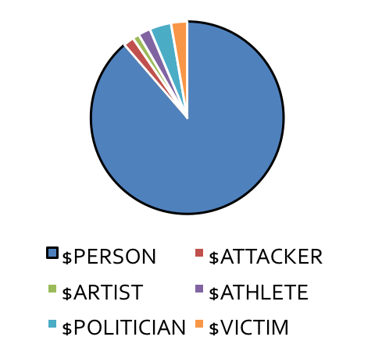
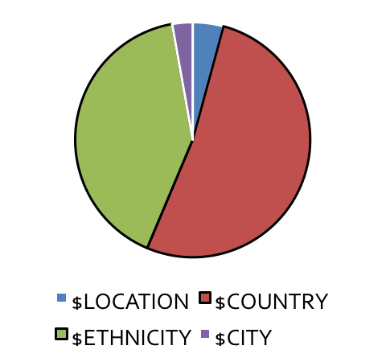
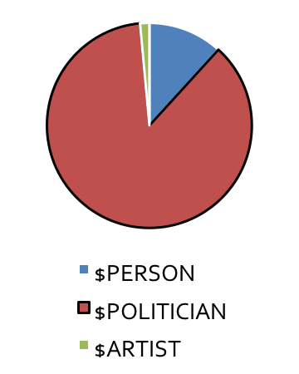
Adjusting Types in Meta Patterns for Appropriate Granularity
$PERSON, $DIGIT,
$COUNTRY president $POLITICIAN
$PERSON’s age is $DIGIT
president $POLITICIAN of $COUNTRY
$PERSON, a $DIGIT -year-old

Slide 50
Results: Patterns, Entities and Attribute Values in News Corpus
Meta patterns | Entity | Attribute value
$COUNTRY President $POLITICIAN $COUNTRY’s president $POLITICIAN President $POLITICIAN of $COUNTRY … $POLITICIAN’s government of $COUNTRY | United States | Barack Obama
 | Russia | Vladimir Putin
 | France | Francois Hollande
 | … | …
 | Burkina Faso | Blaise Compaoré
Meta patterns | Entity | Attribute value
$COMPANY CEO $PERSON $COMPANY chief executive $PERSON $PERSON, the $COMPANY CEO, … $COMPANY former CEO $PERSON $PERSON, the $COMPANY former CEO, | Apple | Tim Cook
 | Facebook | Mark Zuckerberg
 | Hewlett-Packard | Carly Fiorina
 | … | …
 | Infor | Charles Phillips
 | Afghan Citadel | Roya Mahboob

Slide 51
Patterns and Entities Found in Medical Science Corpus
Meta patterns | Entity | Attribute value
$TREATMENT was used to treat $DISEASE $DISEASE using the $TREATMENT $TREATMENT has been used to treat $DISEASE $TREATMENT of patients with $DISEASE … | zoledronic acid therapy | Paget’s disease of bone
 | bisphosphonates | osteoporosis
 | calcitonin | Paget’s disease of bone
 | calcitonin | osteoporosis
 | … | …
Meta patterns | Entity | Attribute value
$BACTERIA was resistant to $ANTIBIOTICS $BACTERIA are resistant to $ANTIBIOTICS $BACTERIA is the most resistant to $ANTIBIOTICS … $BACTERIA, particularly those resistant to $ANTIBIOTICS | corynebacterium striatum BM4687 | gentamicin
 | corynebacterium striatum BM4687 | tobramycin
 | methicillin-susceptible S aureus | vancomycin
 | multidrug-resistant enterobacteriaceae | gentamicin
 | … | …

Slide 52
Comparative Experimental Results
F1 score | ⟨entity type, attribute name⟩ | ⟨entity, attribute name, attribute value⟩
Baselines |  | Stanford’s OpenIE: 0.035
 |  | AI2’s Ollie: 0.131
 | Biperpedia: 0.324 | Google’s ReNoun: 0.309
+Segmentation | +40.0% | +19.4%
+Type Adjustment | +6.5% | +15.0%
+Synonymous | +2.6%
All | 0.495 relatively +52.9% | 0.424 relatively +37.3%

Slide 53
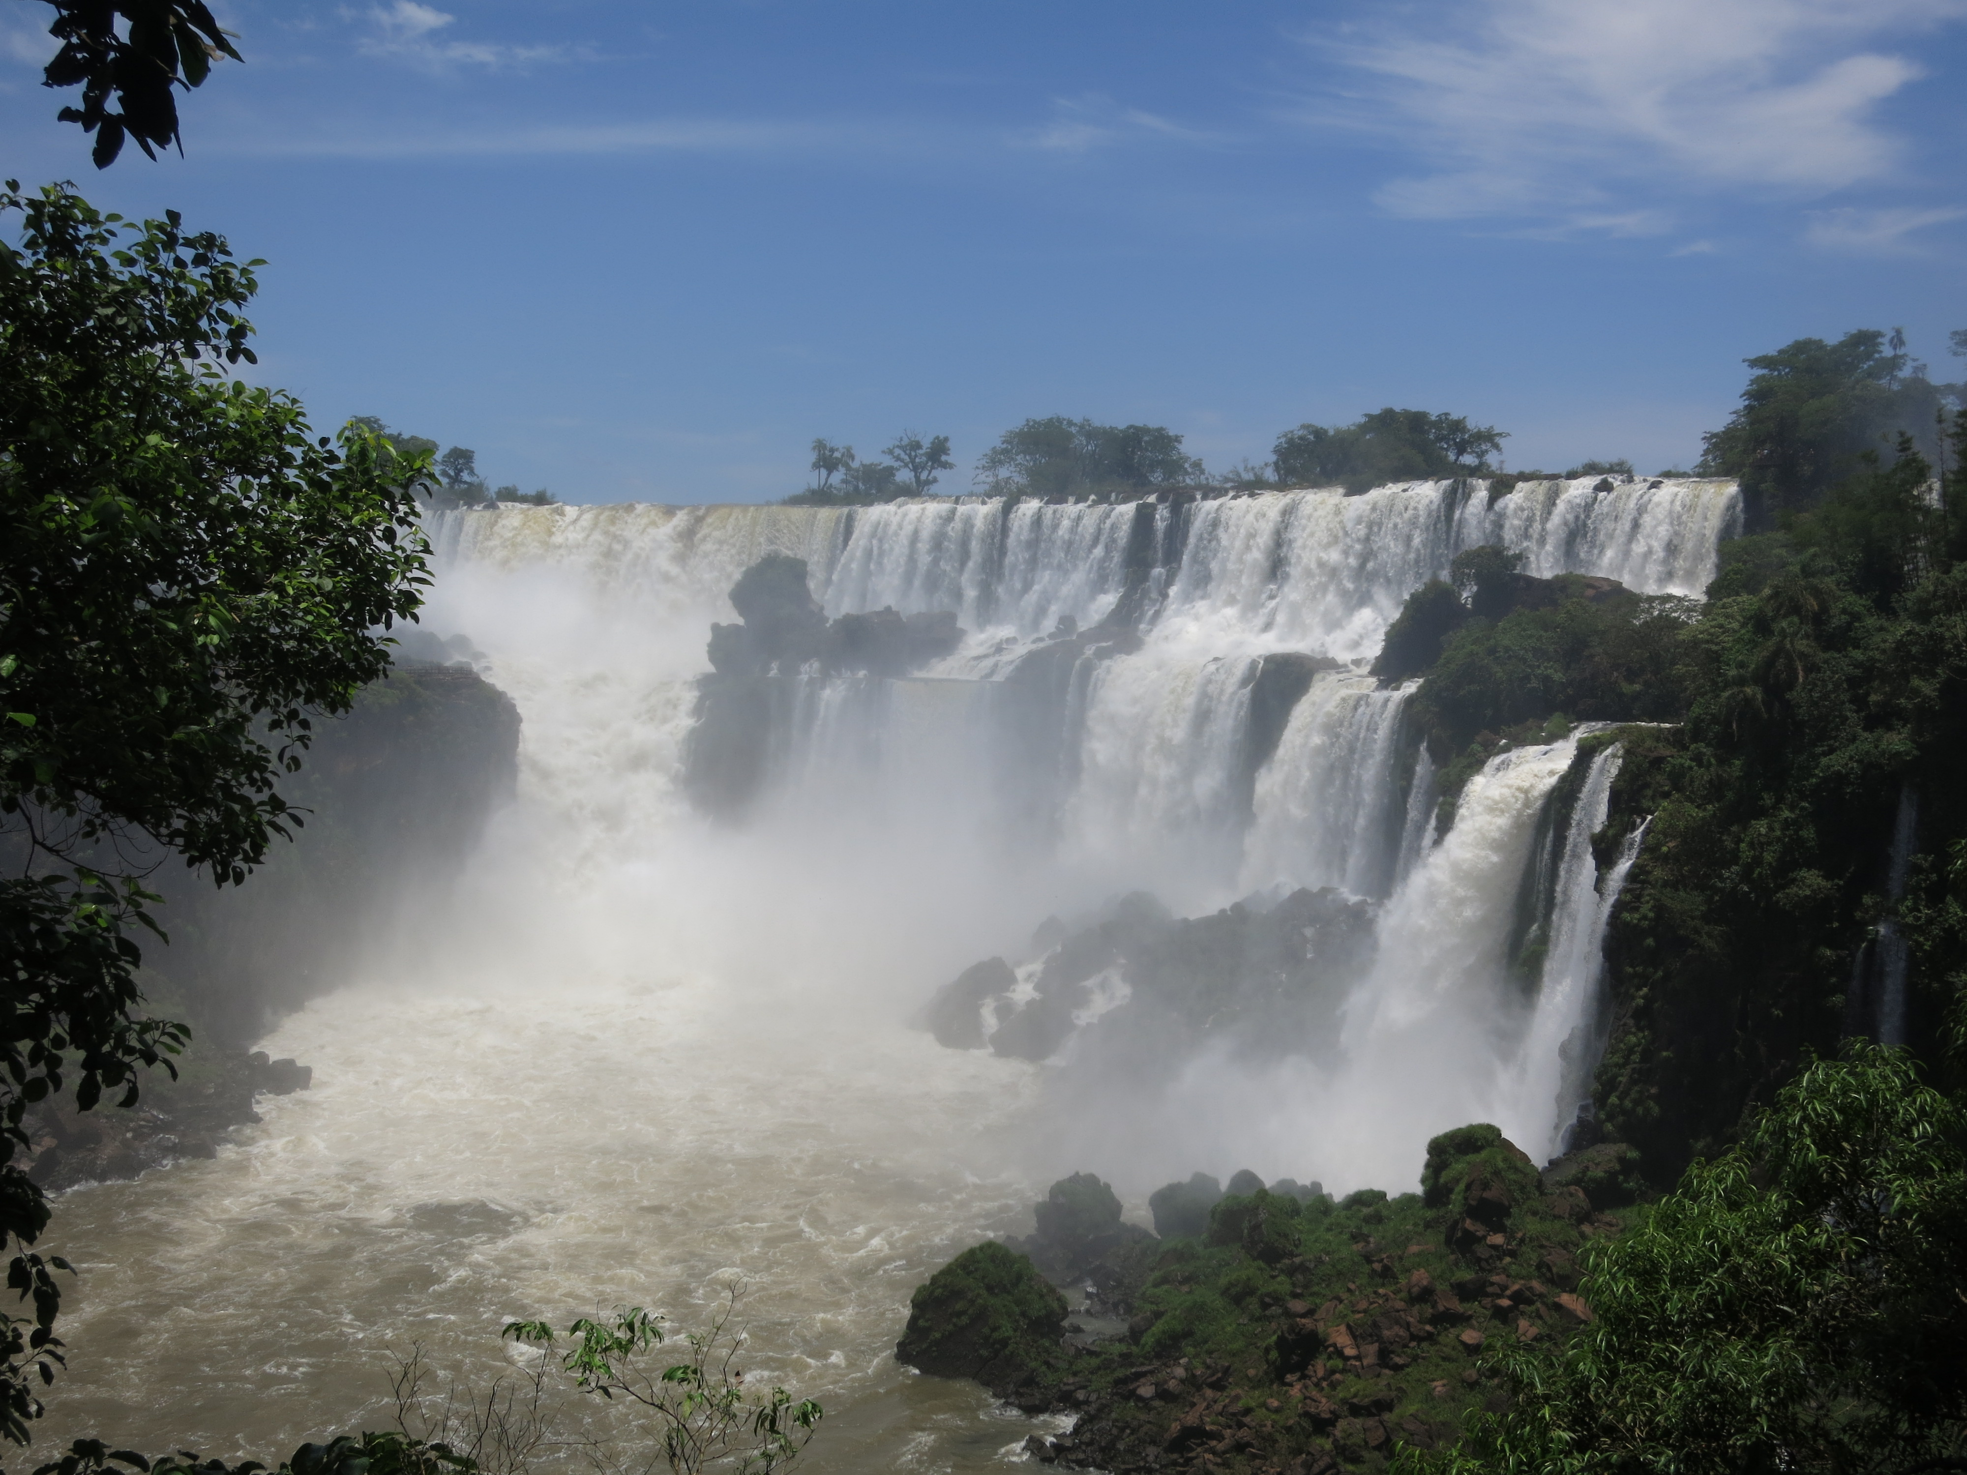

Slide 54
Outline
Learning Embeddings in Networks and Text
LINE: Large-scale Information Network Embedding
Biological Relationship Discovery with Network Embedding
LAKI: Representing Documents via Latent Keyphrase Inference
MetaPAD: Meta Pattern Discovery from Massive Text Corpora
TextCube, EventCube and CaseOLAP
Summary

Slide 55


Multi-Dimensional Text Cube
Numerical data cube (each cell is a numerical value) has been extensively studied
Measures: Numerical aggregations as sum & avg.
Text cube: Each cell contains a set of documents (e.g., Apple, TV, 2016>)
There is an imminent need to do OLAP analysis on text cubes
Dimensions:
Brand: Apple, Samsung, Huawei…
Product: phone, tablet, TV, laptop…
Field: IR, Machine Learning, NLP…
Cell: <Samsung, phone, 2016>
Samsung
Huawei
Text:
Aviation Safety Reports from NASA
Product Reviews from Amazon
Research Papers from DBLP
Apple
phone
tablet
TV
2014
2015
2016

Slide 56
Multi-dimensional Text Cube with Queries & Hierarchies
Query “Illinois economy”
Query “Illinois sports”
Query “United States
presidential election”
Queries:
Point Query: one specific cell
Plane Query: a set of cells
7pm
Champaign
Illinois
Chicago
United
States
Time dimension
New York City
New York
8pm
San Francisco
California
Los Angeles
9pm
Moscow
Russia
Beijing
China
Location dimension
Presidential
election
The
Queen
Stock price
Inflation
GDP
Basketball
Football
Politics
Economy
Sports
Topic dimension
+ dimension k, k+1 ……

Slide 57
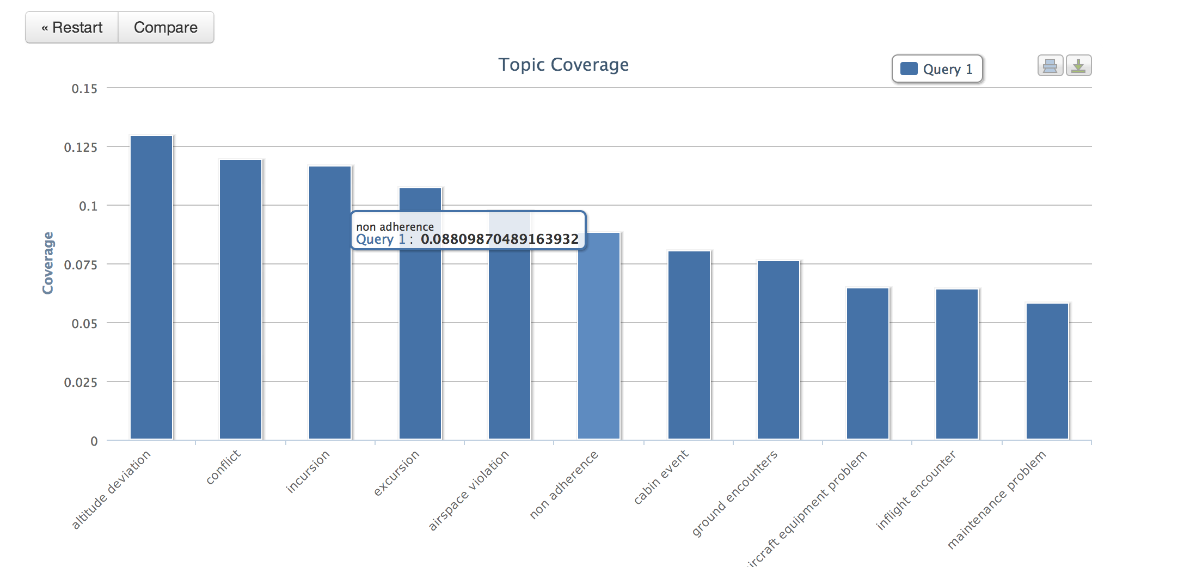
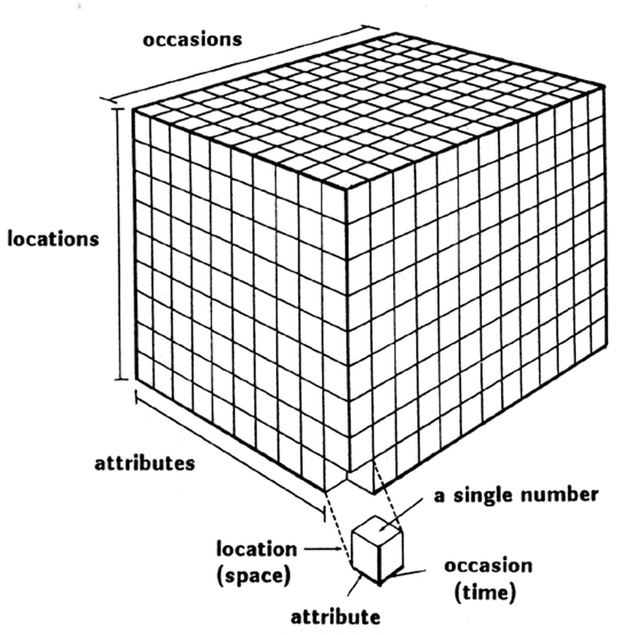
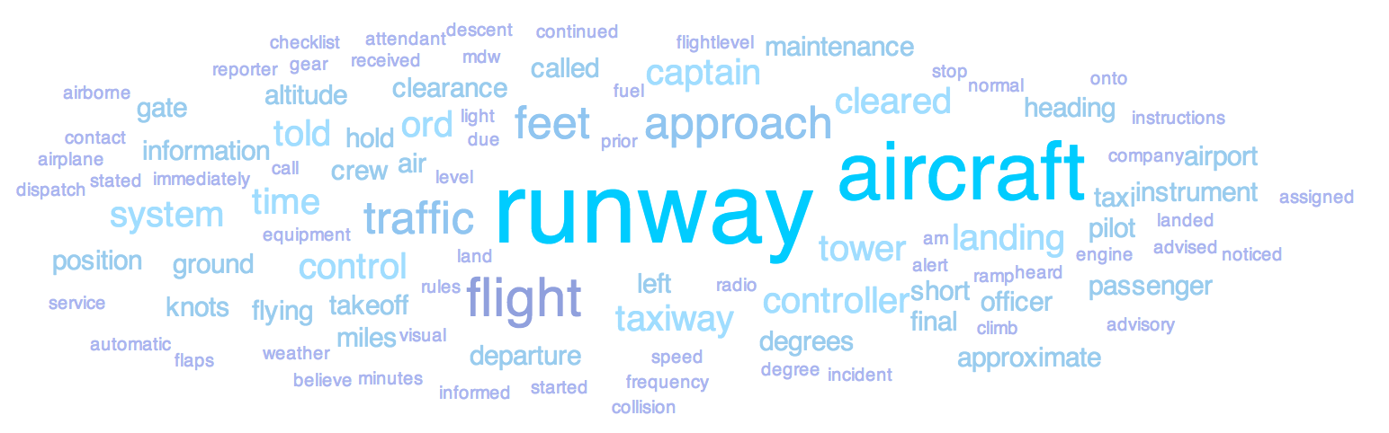
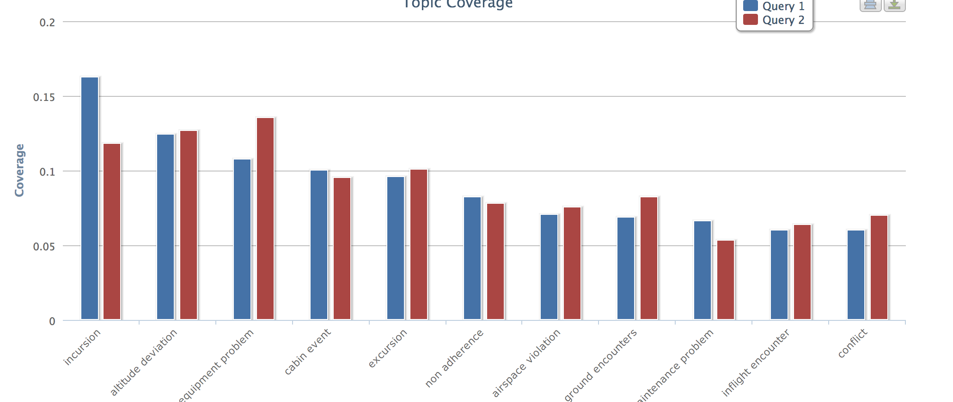
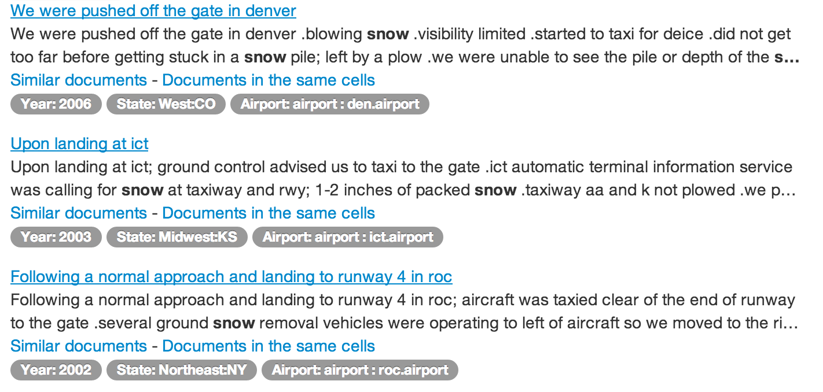
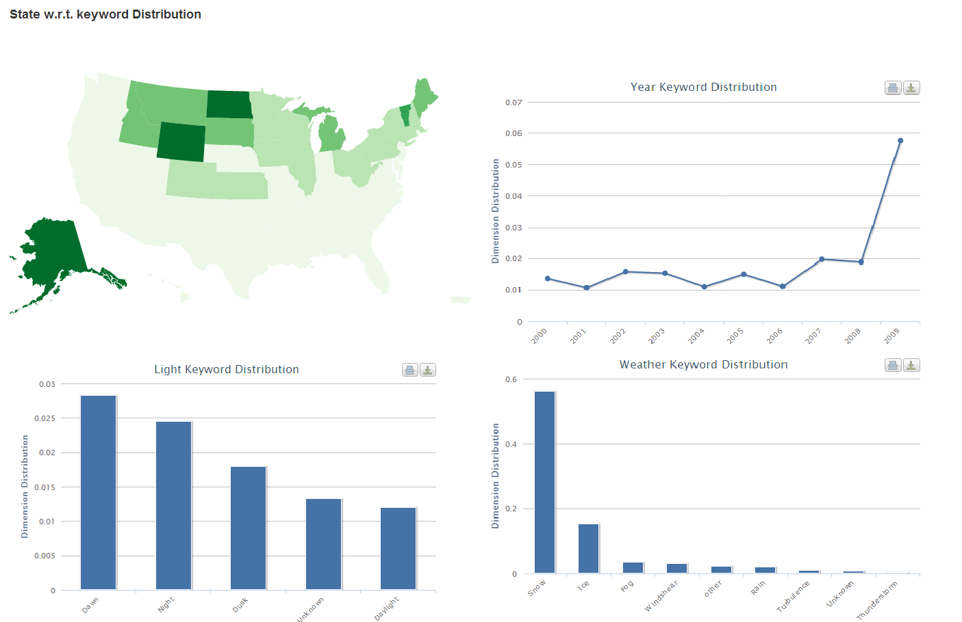
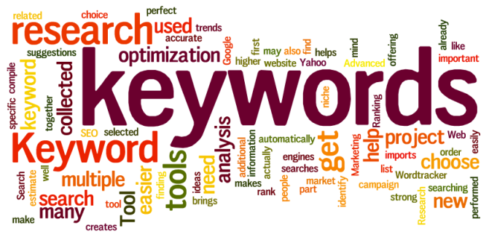
Exploration of Text Cube—Semantic Analysis
Rio
EventCube [KDD’13 demo]: Point Query
Simple summary to support keyword/document search
CASeOLAP [EngBul’16]: Plane Query
Comparative summary/mining
London
Beijing
Soccer
Basketball
Volleyball
Slice
Roll-up
Drill-down
Dice
…
Cube Structure
Textual Analysis
Text Data
Structural Analysis

Slide 58
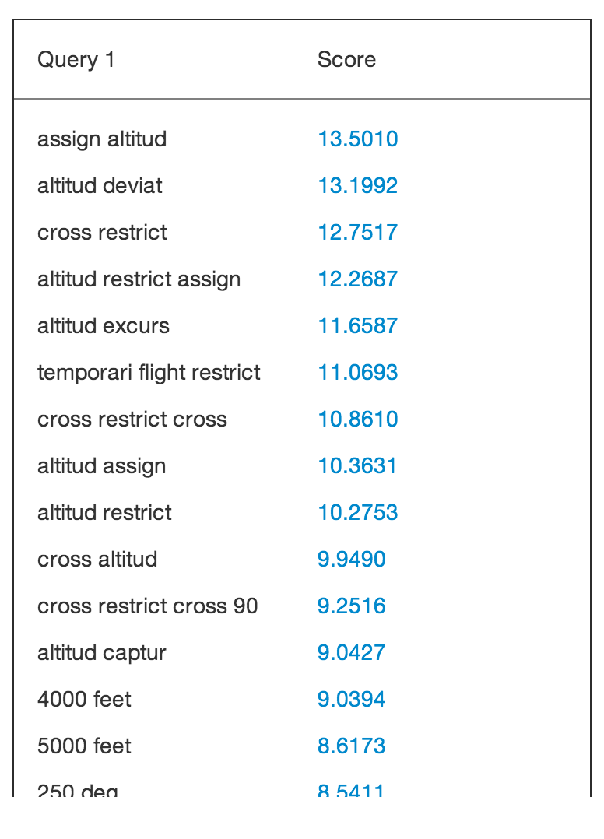
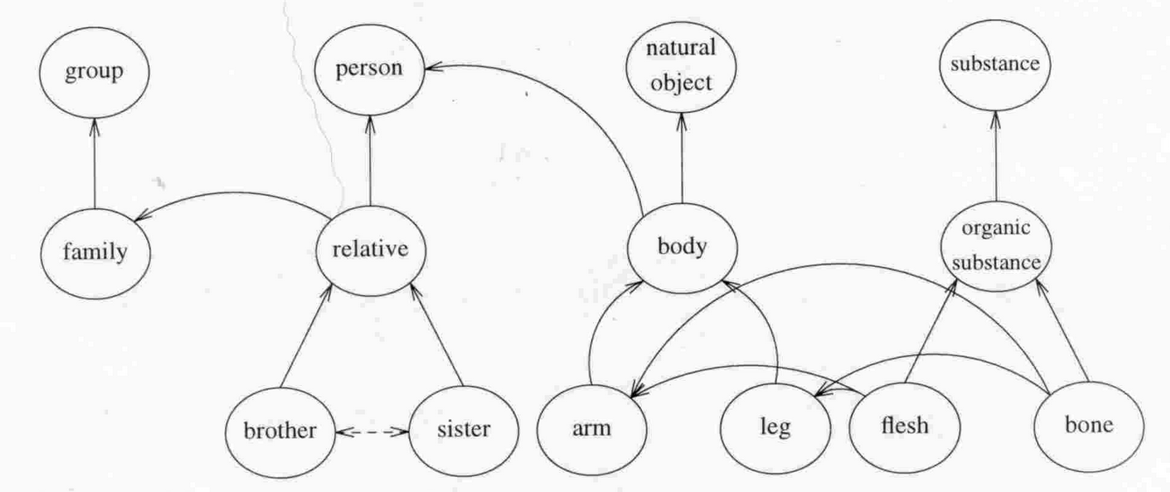
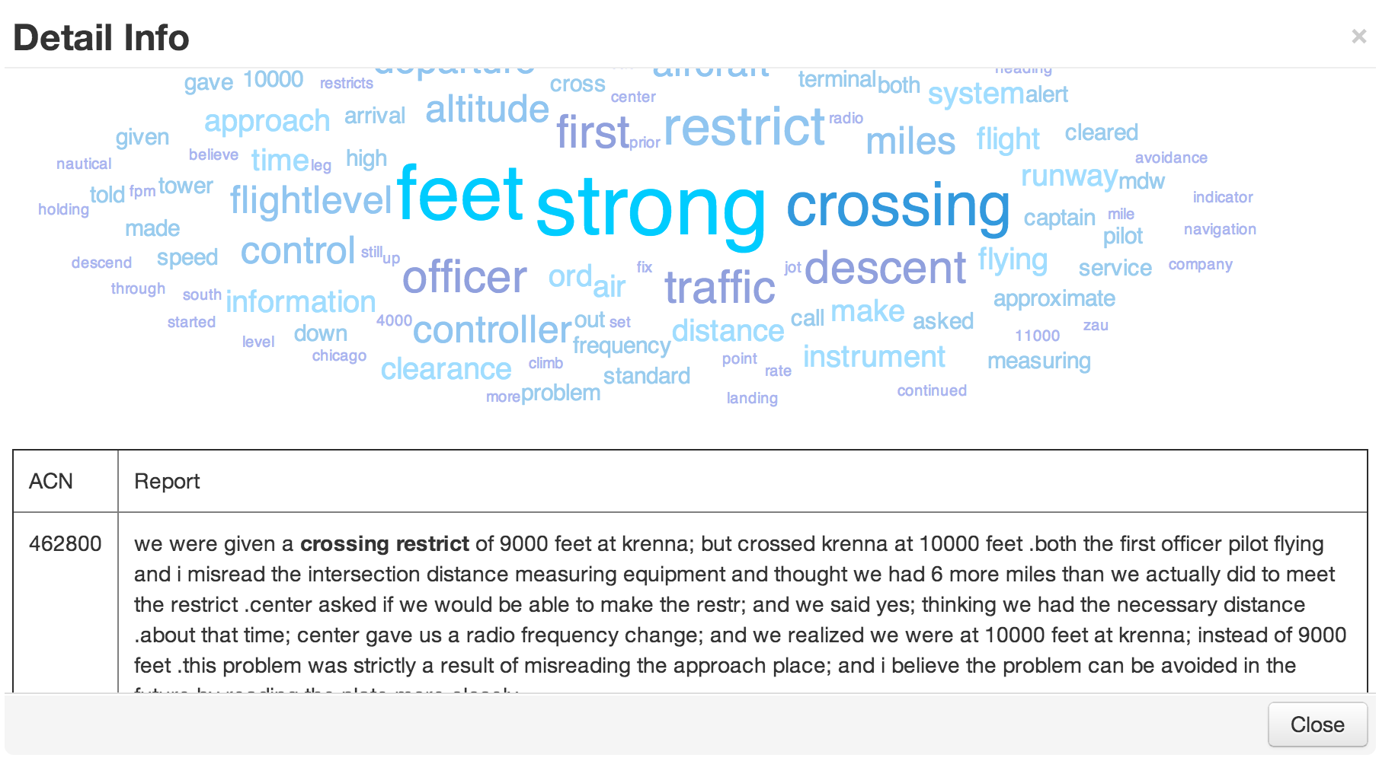
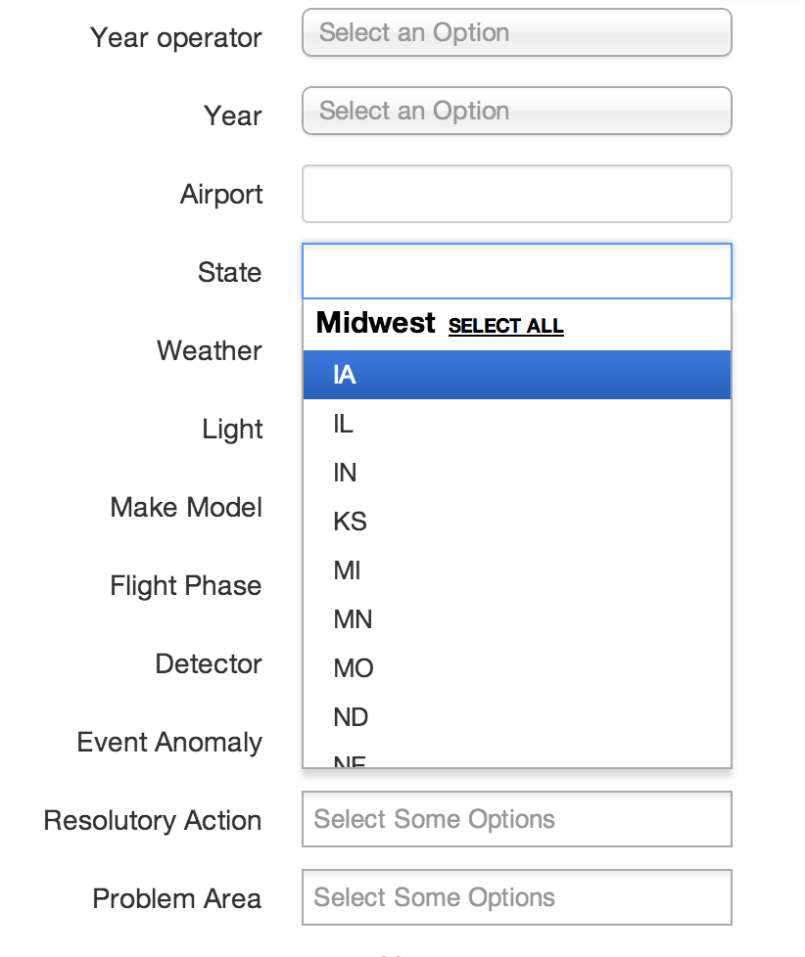
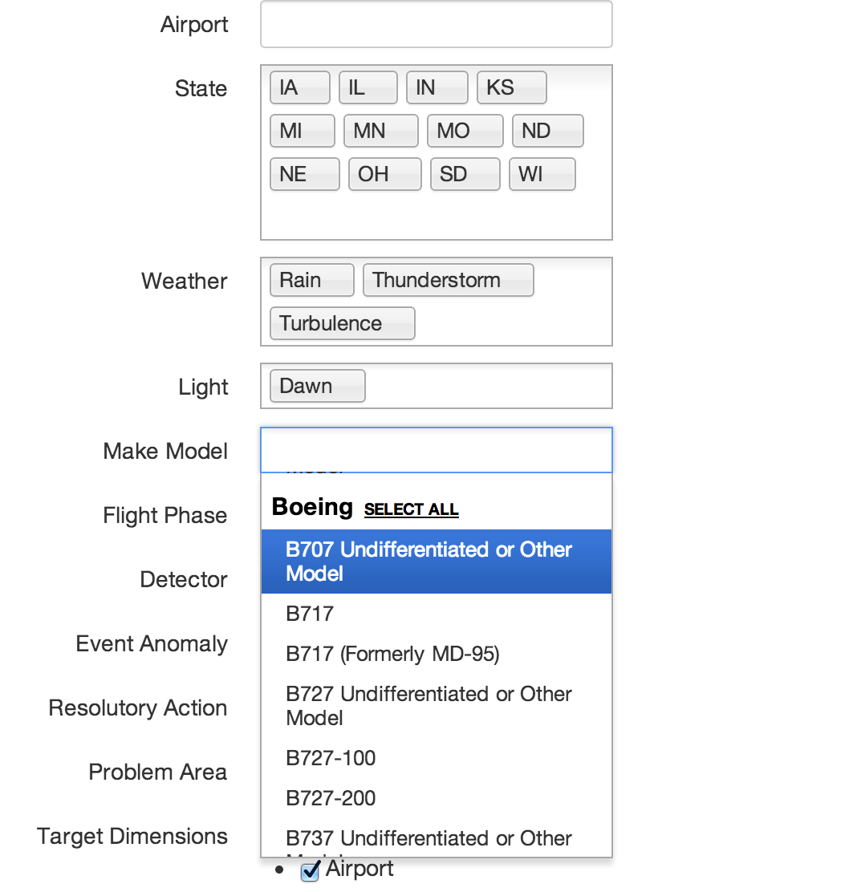
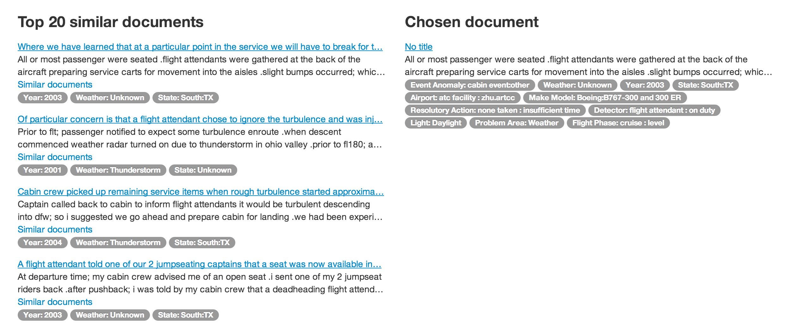
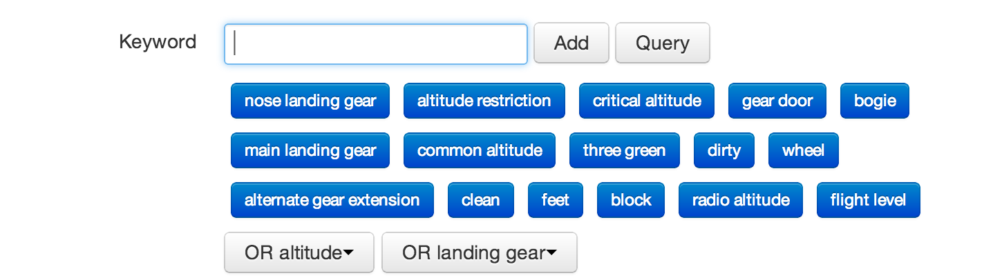
EventCube
Multiple functions supported by EvenCube
Hierarchical Dimension Selection
: support multiple choices
Multi-gram Summarization
Keyword Frequency Distribution
Similar Document Finding
: based on Contextual Search
Contextual Search

Slide 59
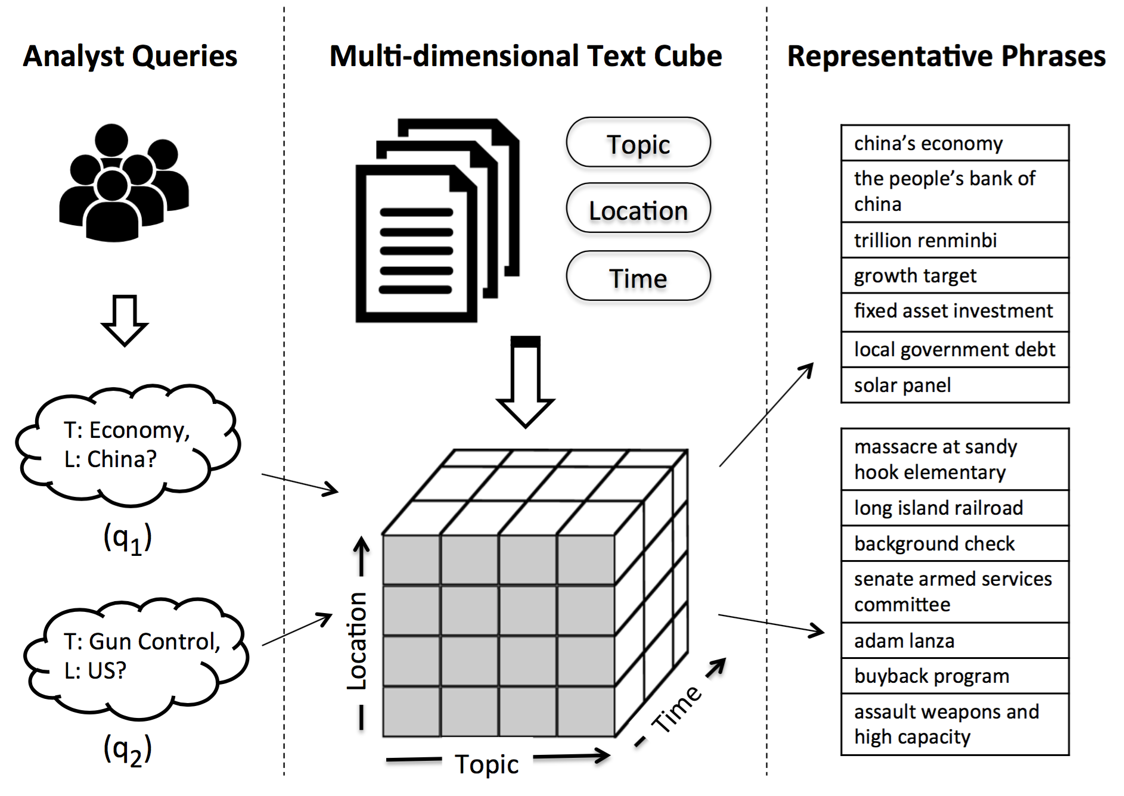
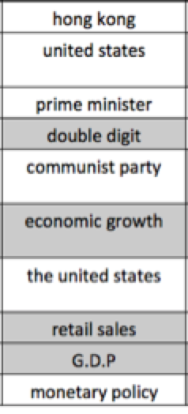
CASE (Context-Aware SEmantic) OLAP
A cell has comparative context
Comparative study is meaningful
Given a query <China, Economy>
Target documents have frequent phrases
Be specific to “China”+“Economy”
Japan
US
China
Economy
Politics
Sports

Slide 60
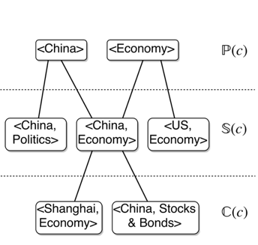
Design Question I: Which Comparative Groups to Pick?
Option 1: User-specified (too much burden to users): undesirable
Option 2: Sibling cells in every dimension (comparable cells)
Japan
US
China
Economy
Politics
Sports

Slide 61
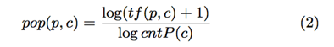
Design Question: How to Score Important Phrases?
Three ingredients
Integrity: meaningful, high-quality phrase
Using SegPhrase as score (>0.7)
Popularity: large # of occurrences in the cell
Distinctness: distinguish the target cell from context cells
A key to have a crisp definition
Combining with geometric mean:

Slide 62
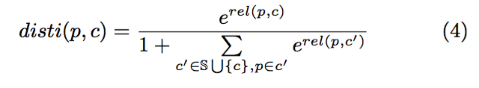
How to Find or Evaluate Distinct Phrases in a Cell?
Judge if a phrase p is distinct in cell c: Transform it into a dual problem
Original problem: Find distinctive phrases for cell c, compared to sibling cells
Transformed problem: Classify phrases into one of the most relevant cell
For a distinct phrase p, if we measure relevance(p, c) for all c
rel(p, c*) >> rel(p, sibling)
Adopt Softmax function as
Japan
US
China
Economy
Politics
Sports
Smoothing
Sibling relevance

Slide 63
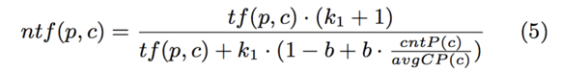


How to Design Relevance Score for a Phrase to a Cell?
Normalized Term Frequency
Treat each cell as a super document
Apply BM25
Normalized Document Frequency
Combine:
Balance cell size
Guarantee spread out!

Slide 64


Experiments
Data:
4,785,990 news articles
Six dimensions
Methods
MCX: based ratio to global background
SegPhrase: Using only integrity score
MCX+Seg: SegPhrase + MCX
TF-IDF: Distinctness by IDF, Popularity by TF
RP (No INT): ablation without integrity
RP (No POP): ablation without popularity
RP (No DIS): ablation without distinctness
RP: our proposed method
Effectiveness
Efficiency

Slide 65


Effectiveness of CaseOLAP on Real-World Datasets
Distinct phrases on 2016 news data
PubMed Abstracts: Distinct relationships between subcategories of cardiovascular diseases and proteins

Slide 66



More on Real-World Case Study: BioData Analysis
CASeOLAP found top-k representative proteins for each Cardiovascular Disease
Protein in IHD & CVA has similar pattern to reveal inflammatory function
Amyloid beta A4 appears to be consistent over 6 groups
Galactosidase had a high score of (5.903), suggesting that glycoproteins and lipids are highly relevant

Slide 67


More on Real-World Cases: Protest News
CaseOLAP helps find top-k representative phrases and helps automatically generate representative video captions

Slide 68


Slide 69
Outline
Learning Embeddings in Networks and Text
LINE: Large-scale Information Network Embedding
Biological Relationship Discovery with Network Embedding
LAKI: Representing Documents via Latent Keyphrase Inference
MetaPAD: Meta Pattern Discovery from Massive Text Corpora
TextCube, EventCube and CaseOLAP
Summary

Slide 70
Summary
A promising integrated approach for text analysis
Text mining + embedding + information network analysis
Embedding for text analysis
LINE + PTE + information network approach (e.g., meta path-guided analysis)
Representing documented by in-depth semantic analysis
LAKI and beyond
MetaPAD: Meta Pattern Discovery from Massive Text Corpora
Facilitate information extraction from massive text using meta-patterns
CaseOLAP: Distinctive analysis of documents in multi-dimensional space
Many more to be studied

Slide 71
References
JianTang, Meng Qu, Mingzhe Wang, Ming Zhang, Jun Yan, and Qiaozhu Mei, “LINE: Large-scale information network embedding”, WWW'15
JianTang, Meng Qu, and Qiaozhu Mei, “PTE: Predictive text embedding through large-scale heterogeneous text networks”, KDD'15
Jialu Liu, Xiang Ren, Jingbo Shang, Taylor Cassidy, Clare Voss and Jiawei Han, “Representing Documents via Latent Keyphrase Inference”, WWW'16
Meng Jiang, Jingbo Shang, Taylor Cassidy, Xiang Ren, Lance M. Kaplan, Timothy P. Hanratty, and Jiawei Han, “MetaPAD: Meta Pa.ern Discovery from Massive Text Corpora”, submitted for publication, 2017
Alon Halevy, Natalya Noy, Sunita Sarawagi, Steven Euijong Whang, and Xiao Yu, “Discovering structure in the universe of a.ribute names”, WWW’16
Fangbo Tao, Honglei Zhuang, Chi Wang Yu, Qi Wang, Taylor Cassidy, Lance Kaplan, Clare Voss, Jiawei Han, “Multi-Dimensional, Phrase-Based Summarization in Text Cubes", Data Eng. Bulletin 39(3), Sept. 2016

Slide 72


Slide 73
PTE: Predictive Text Embedding
Text Representation
Learning meaningful text representations is important for various machine learning tasks
Bag of words:
Sparsity
Ignore the relatedness between different words
Text Classification
Text Clustering
Retrieval

Slide 74
Recent Studies
Distributed Representations
Embed text into a low-dimensional space
Word2vec, Paragraph Vector
Strength:
Low-dimensional vectors; similar texts have similar vectors; efficient
Weakness:
Totally unsupervised; Can’t guide the training
Convolutional Neural Network
Used for text classification
The hidden layer can be used for text representation
Strength: High accuracy
Weakness: Totally supervised;
Slow to train; Training is very tricky

Slide 75
Effective Text Representations
Desired Features for Effective Text Representation
Semi-supervised
Use labeled data to guide the training and boost the performance
Learn from massive unlabeled text data
Low-dimensional vector representations & Efficient
How to realize such an effective representation?
A prerequisite of learning good text representations is to train effective word representations
Texts consist of words: To understand a text, we should first know the words well
Learn effective word representations
Distributional Hypothesis
words that occur in the same contexts tend to have similar meanings
Use multiple contexts to train word representations

Slide 76
The PTE Method
Three different contexts:
Unsupervised: word document
Supervised: label
Use Heterogeneous Information Networks to represent the co-occurrence relationship between words and contexts

Slide 77

Learn Word Embedding from Hetero. Info. Networks
For a single context:
$O_{c}=\sum_{w,c}{{\hat{P}}_{wc}logσ(}\vec{w}∙\vec{c})+K\sum_{w,c}{{\hat{P}}_{w}}{\hat{P}}_{c}logσ(−\vec{w}∙\vec{c})$
For all three contexts:
$O_{pte}=O_{word}+O_{doc}+O_{label}$
Pre-training + Fine-tuning
Joint Training

Slide 78

Infer Text Embedding
Taking average of word embedding
For $d=\left[w_{1},w_{2},{…,w}_{n}\right] \vec{d}=\frac{1}{n}\sum_{k=1}^{n}{\vec{w_{k}}}$
Ignore word order
Efficient and effective in most cases
Using Recursive NN or Recurrent NN
Consider word order
Too slow

Slide 79
Experiments: Setup and Results
Datasets
Task:
Text classification: Metric: Macro-F1 Micro-F1(accuracy)
Baselines: BOW, Skip-Gram, PVDM, PVDBOW, CNN

Slide 80
Experimental Results
Results on Long and short documents

Slide 81
Performance & Visualization Results
Performance comparison on percentage of labeled data
Visualization results

